Slide 1


Thesis defense: 14th August 2024
Behind Enemy Lines: Investigating Crozier’s Paradox and Recognition of Nestmates through an Individual Based Model
Lakshya Chauhan MEME 2022 – 2024
Supervisors: Dr. Bieuville, Dr. Menzel, Prof. Kokko

Slide 2
Introduction

Slide 3
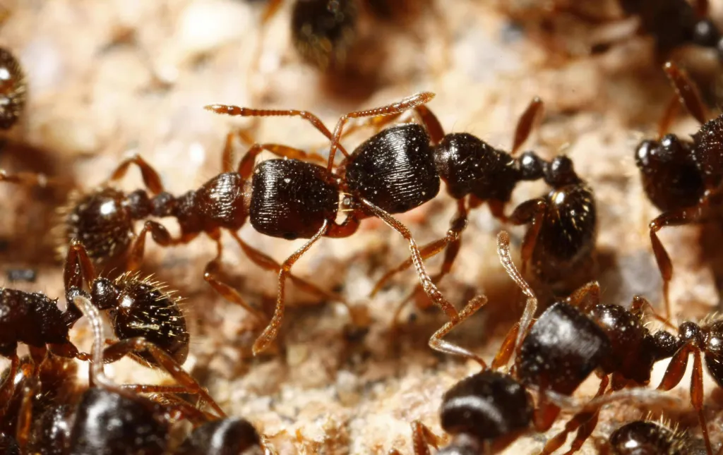
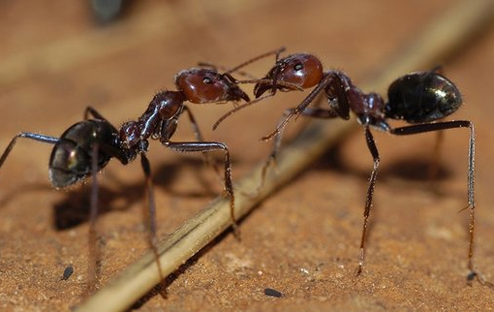

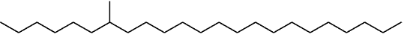
Nestmate recognition in ants
Context dependent
War?
Peace?
Highly complex
Mimicry
Cuticular Hydrocarbons (CHCs)
Time variable
Sturgeon & Gordon., 2012 Martin & Drijfhout., 2009

Slide 4

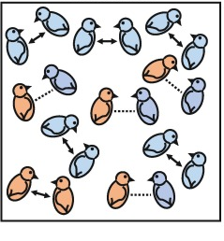

Crozier’s Paradox
Alternate selection pressures?
Genetic kin recognition system exists?
Yes
Benefits to relatives/Costs to non-relatives?
Rossiter H. Crozier
Yes
Loss of diversity?
Only genetic basis to recognition
Random mating
No spatial organization
Yes
Loss of recognition system
Sea Anemones
Crozier., 1986 Scott et al., 2022

Slide 5





Solutions to Crozier’s Paradox
Opposing selection pressure in resource acquisition?
Disassortative mating
Steal from nest
Pleiotropy
Rejected
Beard chromodynamics
Decoupling CHC profile and perception
Multiple social encounters before interaction
Holman et al., 2013 Leonhardt et al., 2016 Scott et al., 2022
Notes:
1)
2) Parasitism needs to evolve super fast
3) Second, it has been shown theoretically that genetic kin recognition can be stable even without multiple social encounters, if there is: extreme spatial structure (low migration); tight linkage between the tag locus and the helping (trait) locus; strong selection. This hypothesis has been called ‘beard chromodynamics’ because of its reliance on physical tag-trait linkage, which is a characteristic of greenbeard genes.

Slide 6
Model

Slide 7
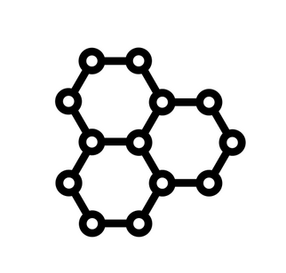
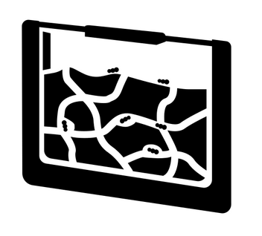
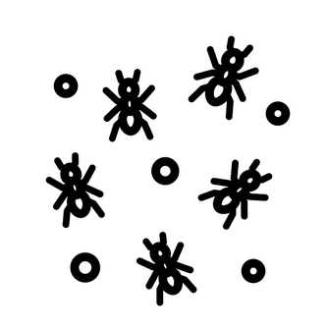




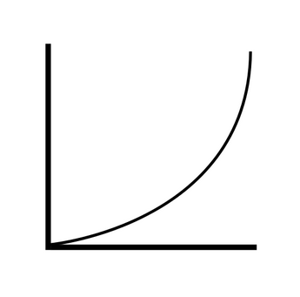
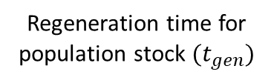
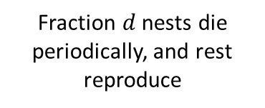
Setup and Lifecycle
Can forage from population stock/steal
Choice to steal/forage depends on distribution of food between population and nest stocks
Fraction $d$ nests die periodically, and rest reproduce
If nest stock goes negative, it dies
Cue profile (10 Cues)
Simulated time
50 Nests
10 Workers
Food acquired is used to produce CHCs
Regeneration time for population stock $(t_{gen})$
Gillespie’s algorithm utilized for worker action times
Recognition curve

Slide 8
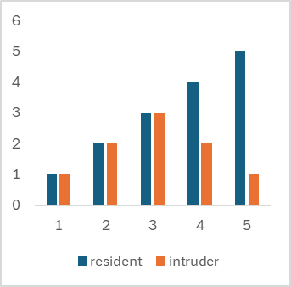
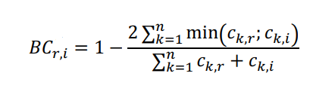
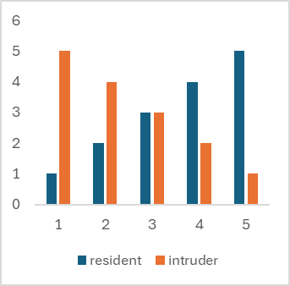
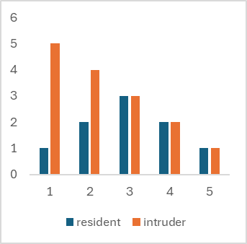
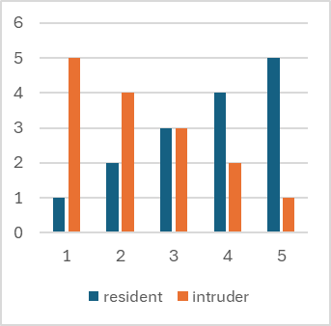
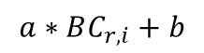
Recognition system
Workers undergo recognition procedure whenever entering foreign nest or their parent nest.
Undergo mutation and inheritance if co-evolving with cues
Desirable-present
$$a∗BC_{r,i}+b$$
Undesirable-absent
Rejection probability
Chemical distance
If accepted, they steal/deposit a food unit
Gestalt

Slide 9
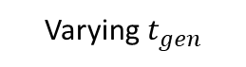
Controls and parameters varies
Can cue diversity persist under the scope of our assumptions contrary to what Crozier’s paradox says?
Average Cue Diversity
Model Control (M)
Varying $t_{gen}$
Varying metabolic cost of CHC production
Average Cue Abundance
Controls
Population Control (P)
Metrics collected
Conditions explored
Success rate of stealing attempts
Varying selection strength
Varying mutation rate for cues
Drift Control
Continuous food regeneration
#initial lineages surviving

Slide 10
Results 1: Evolving Cues

Slide 11
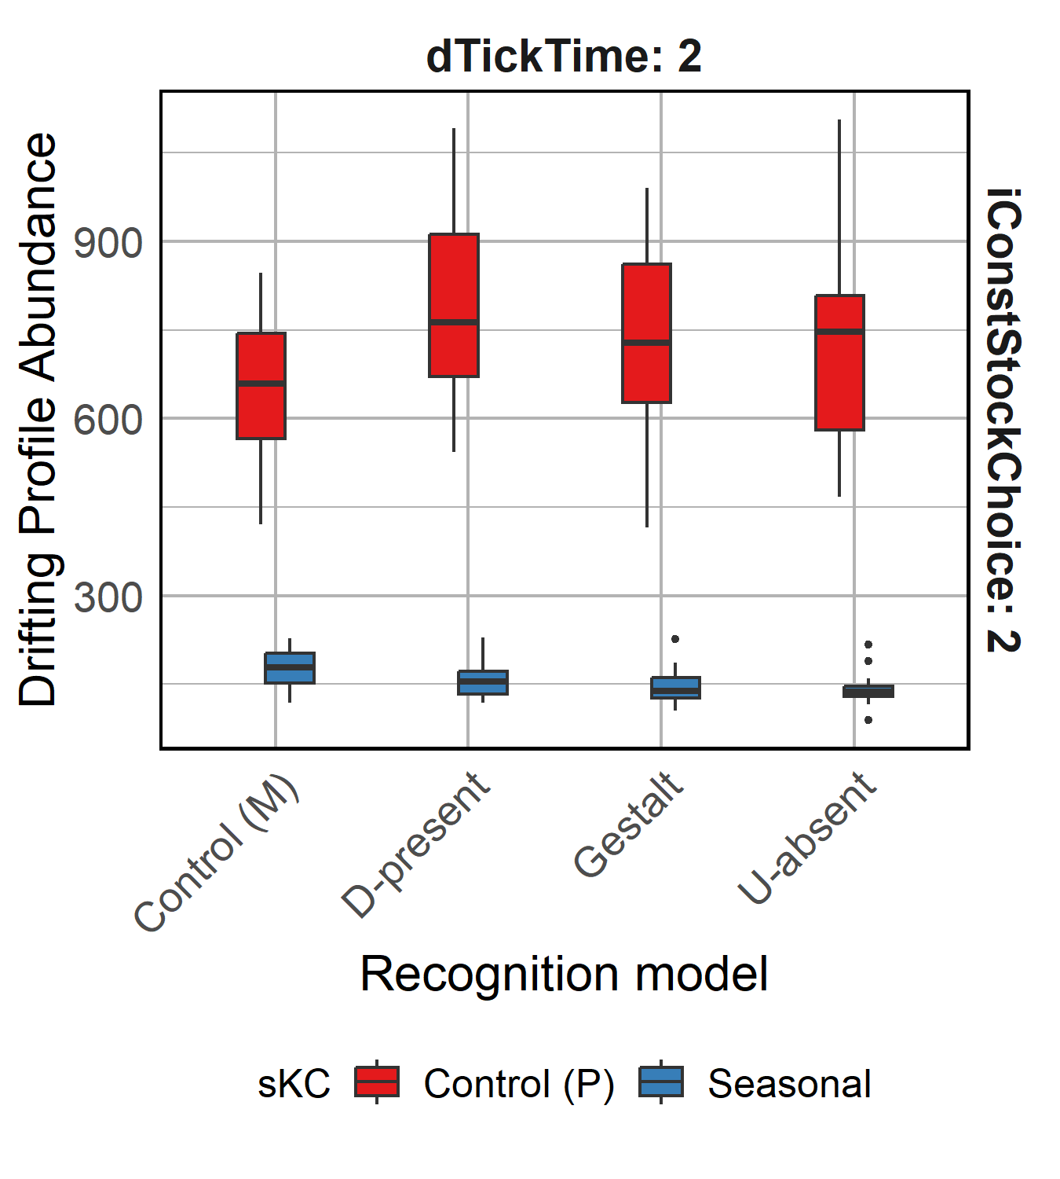
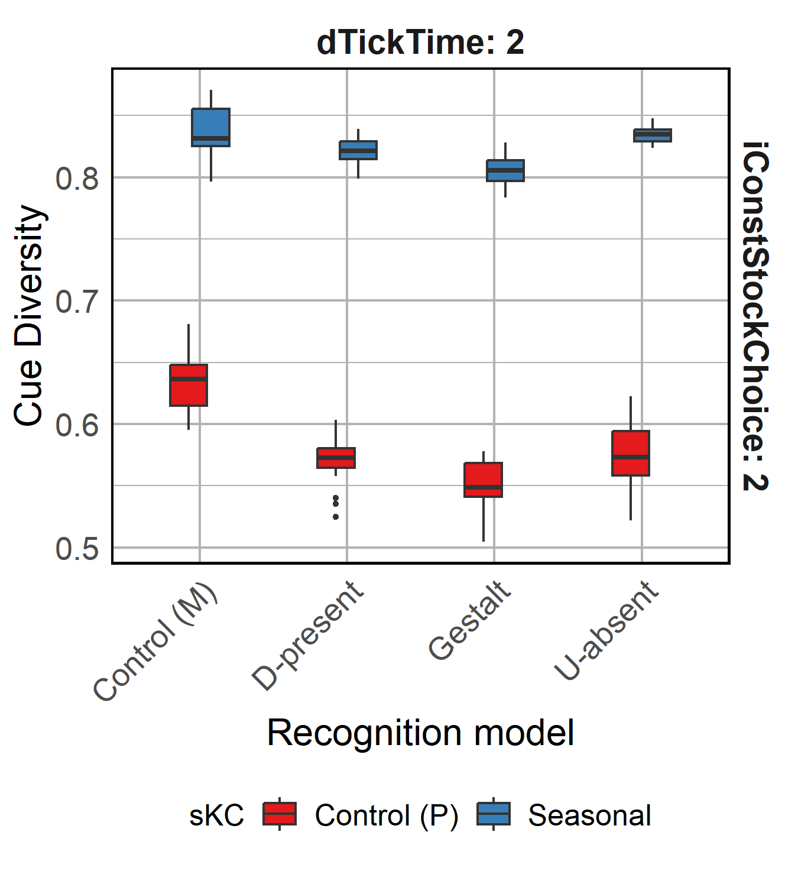
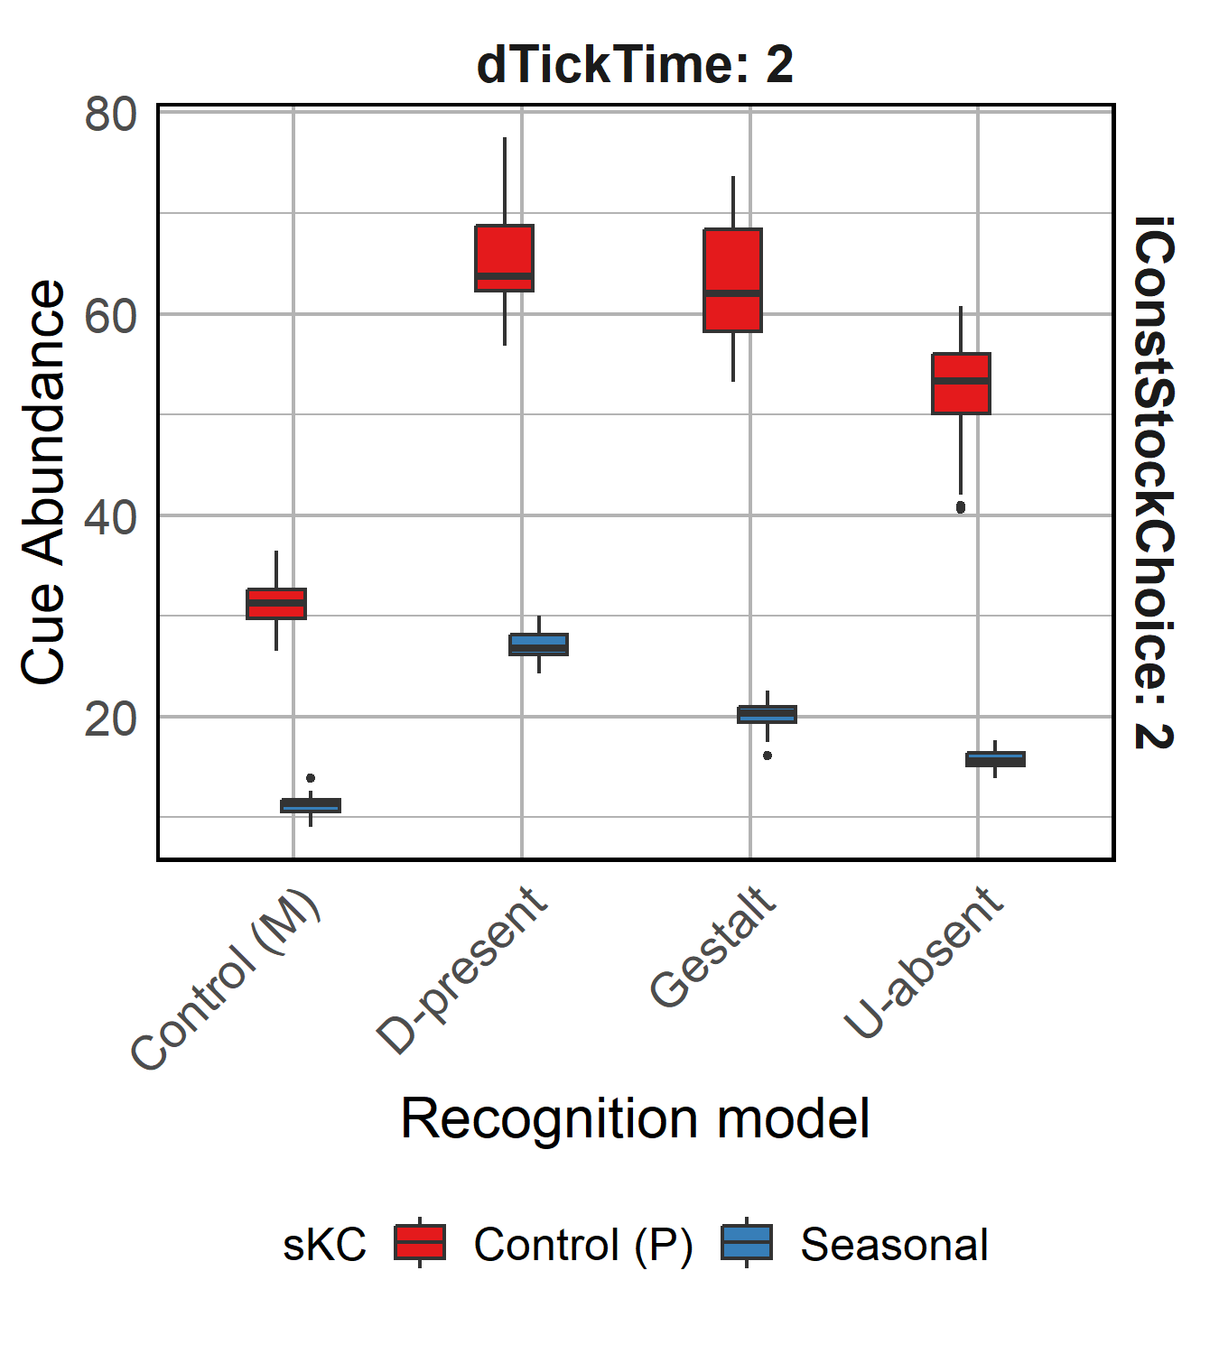
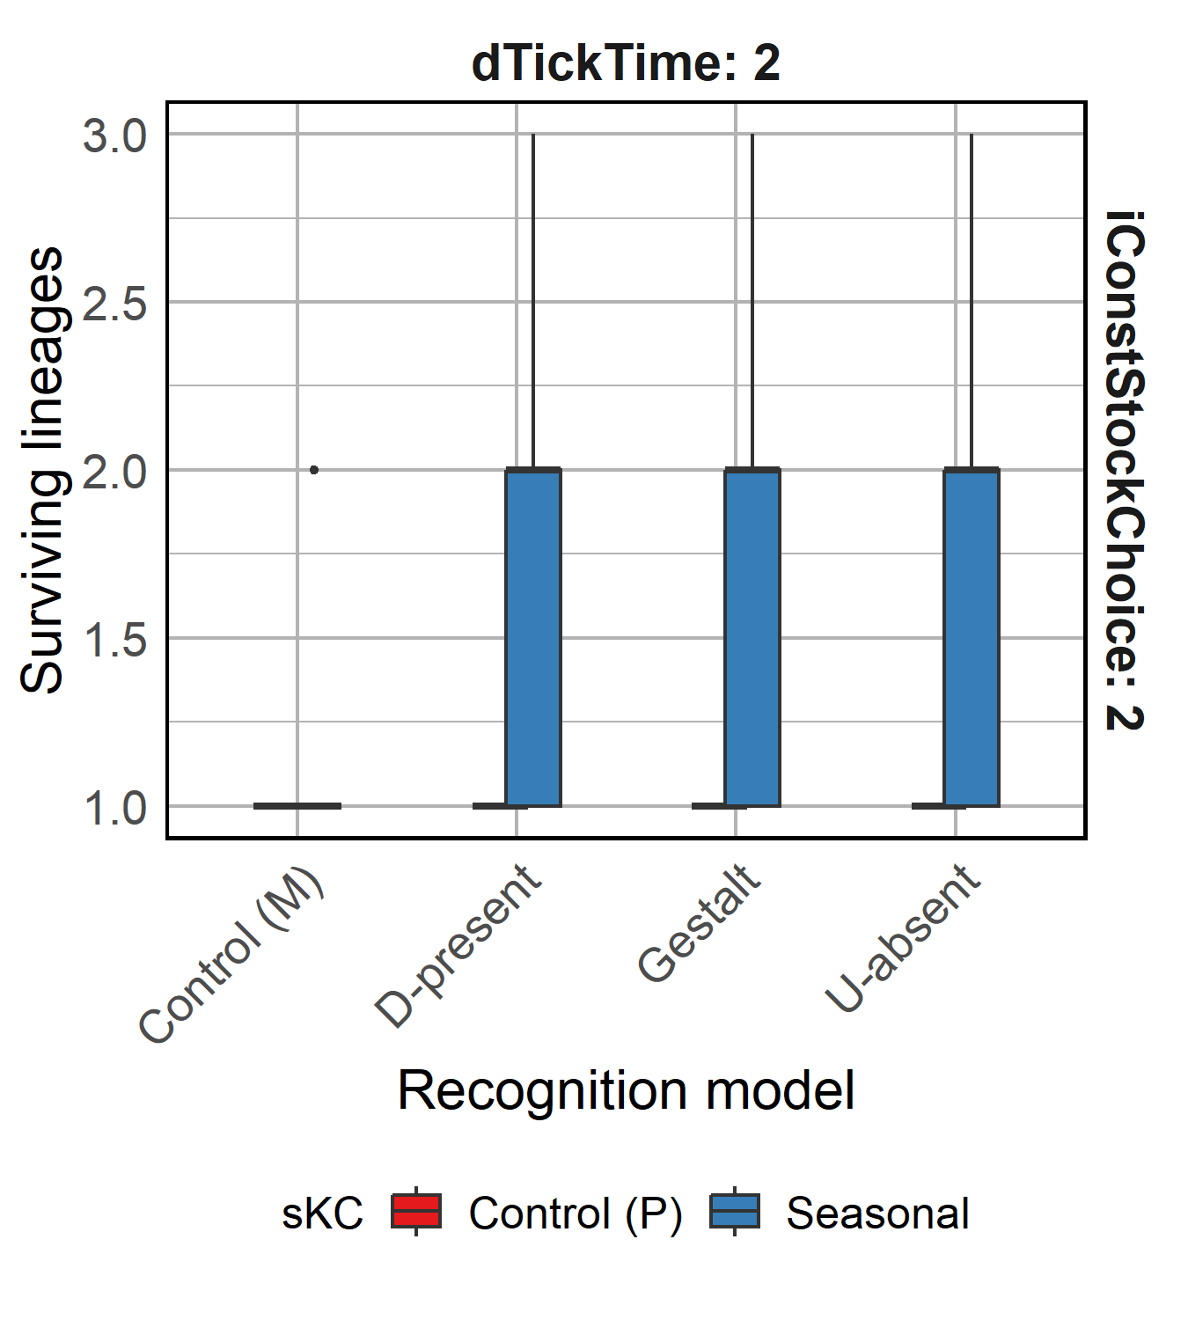
R1.1.1 Cue diversity is maintained
Higher Cue-diversity and lower Cue-abundance evolved
Cue-diversity can persist even if a single lineage survives
Selection still acting on Control (P)
Notes:
NUMBER OF CUES
Generalist vs Specialist

Slide 12
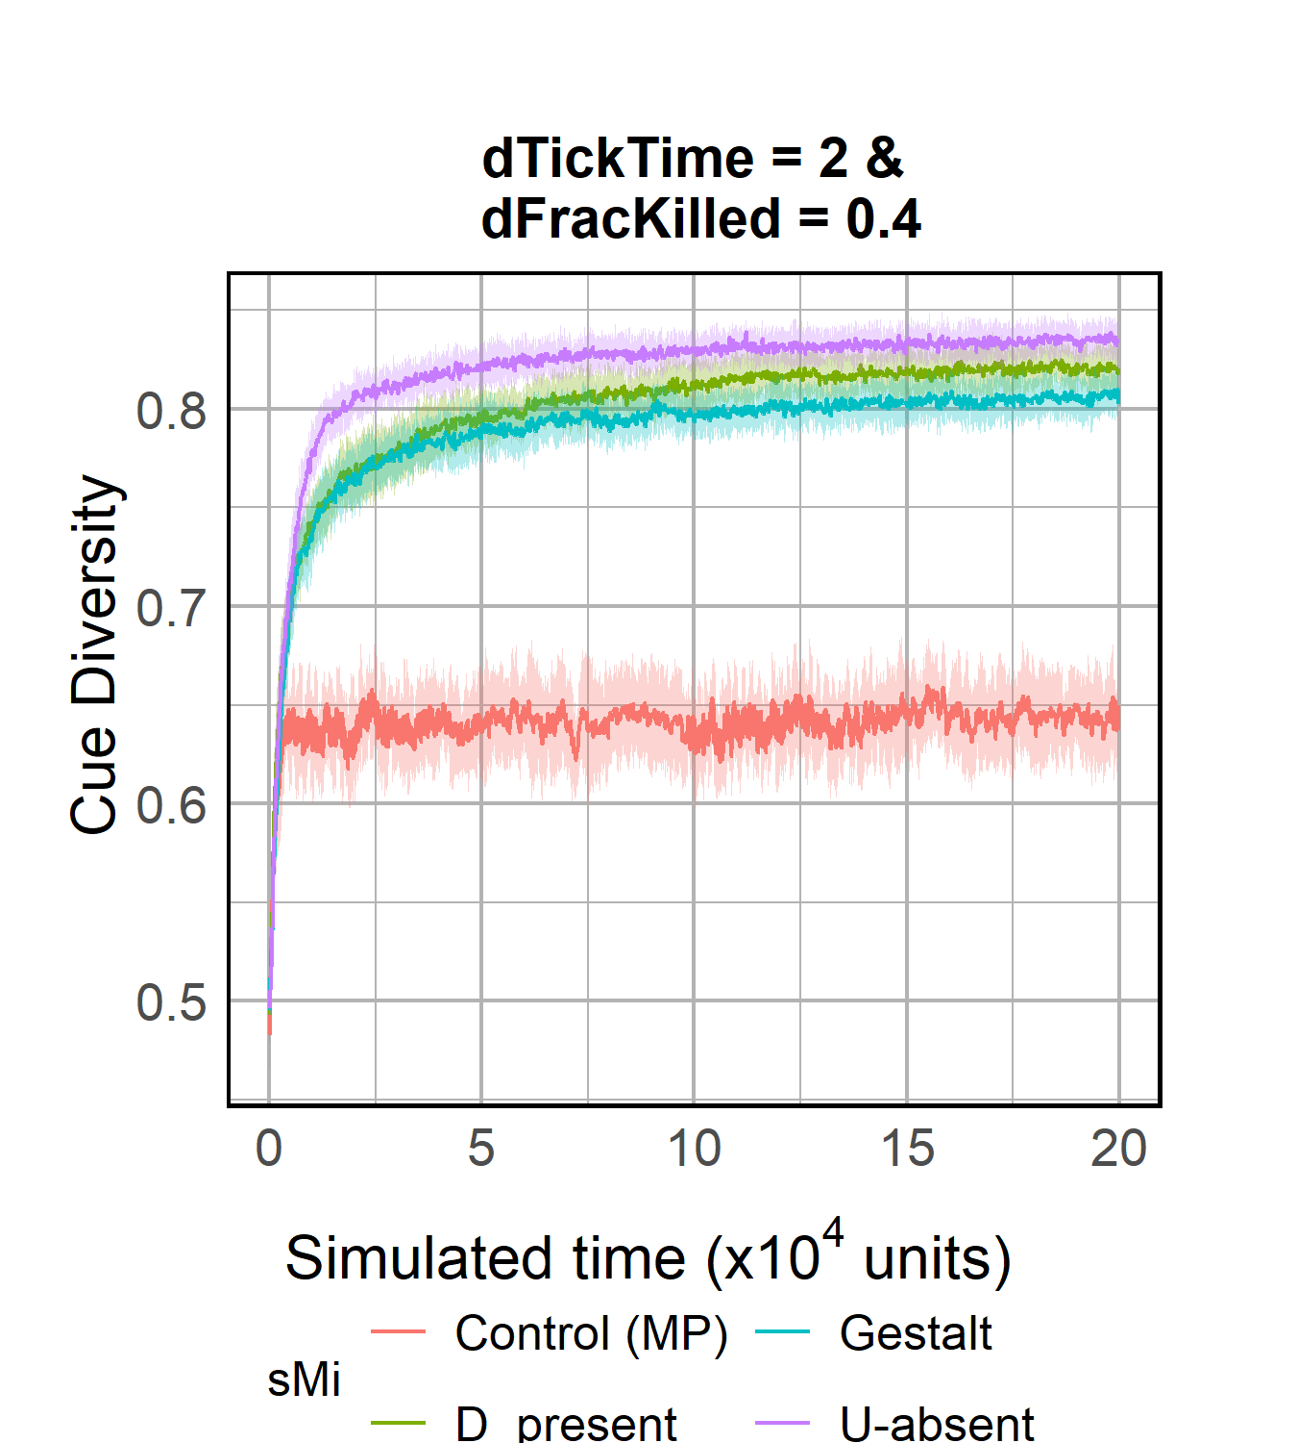
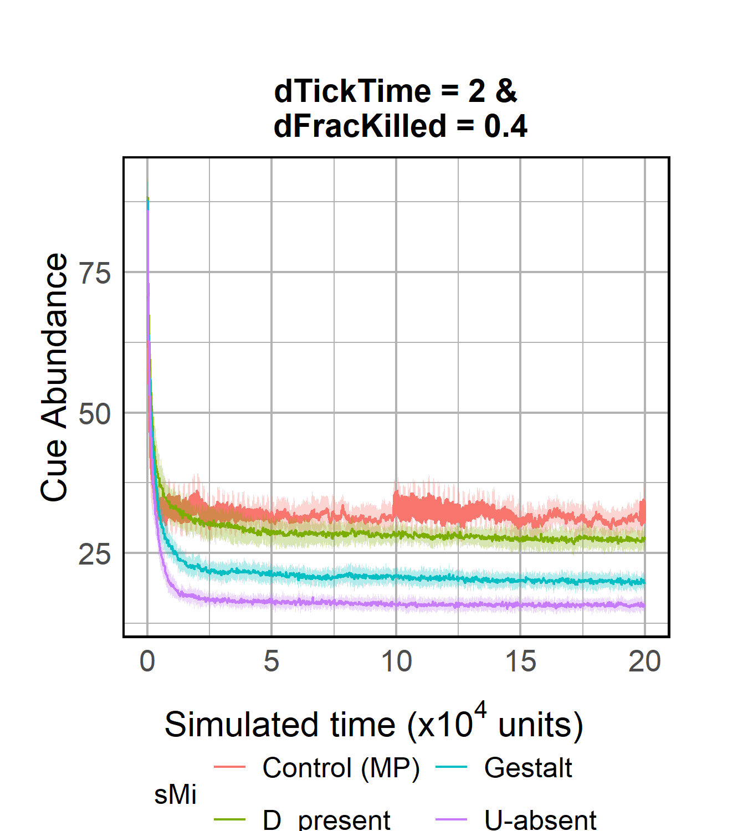
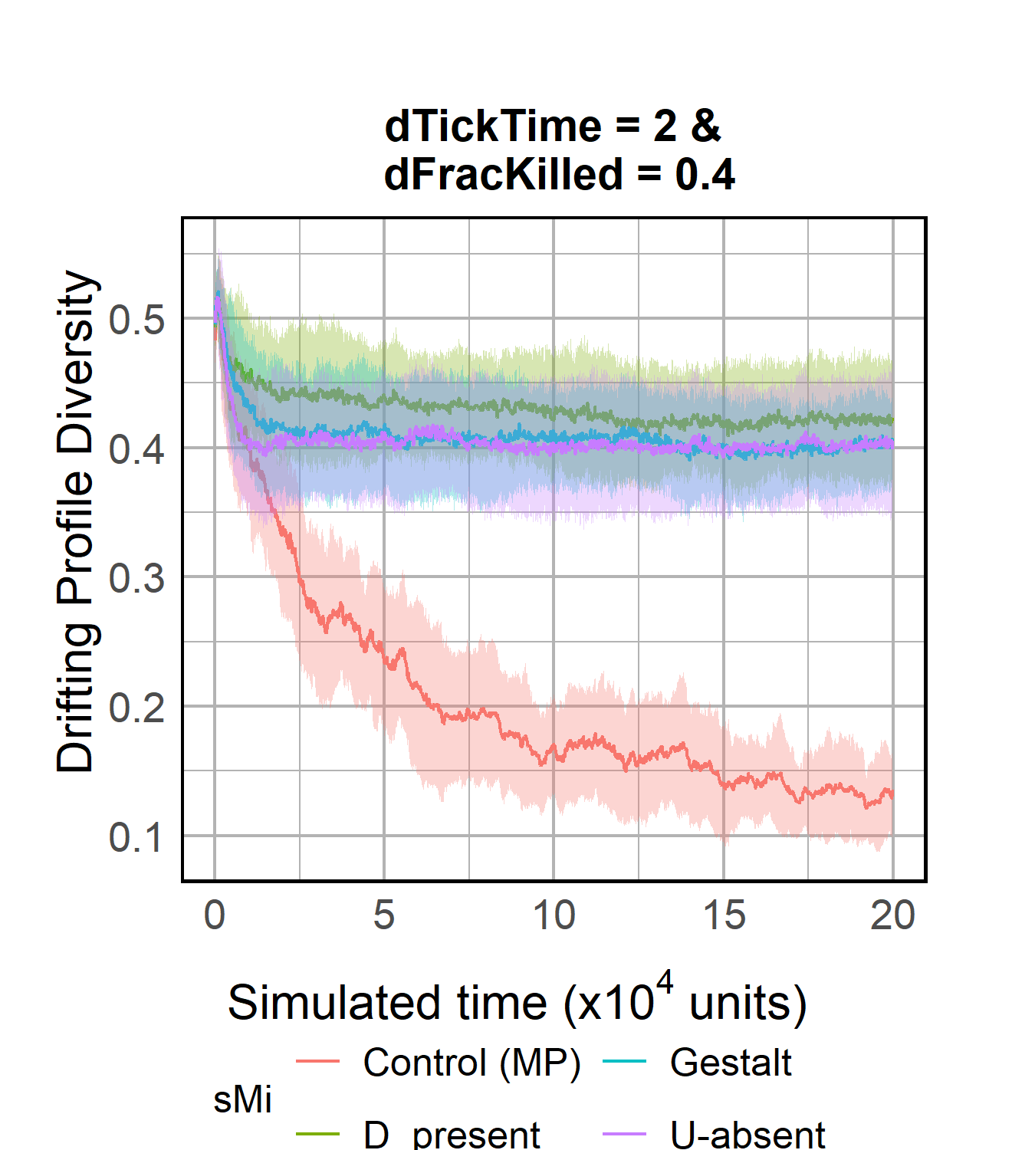
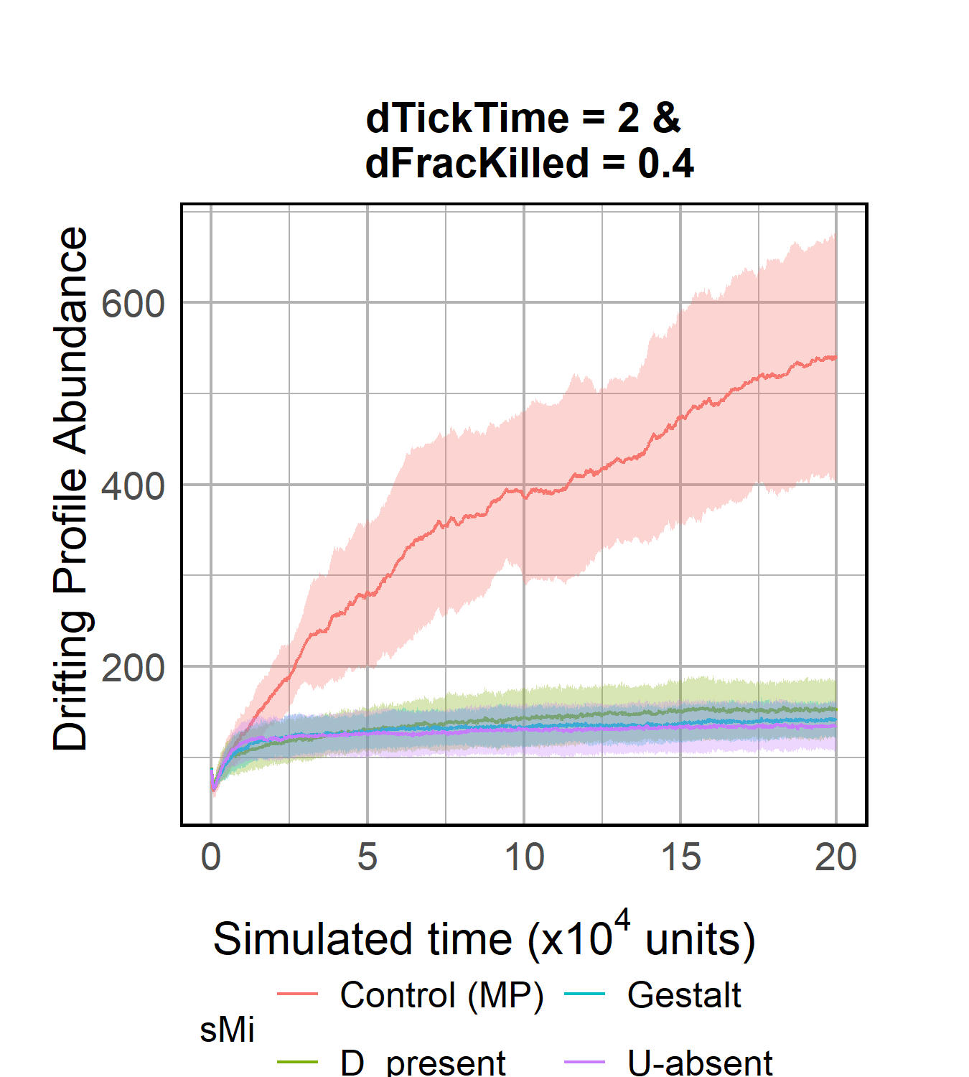
R1.1.2 Drift control
Compared to Drift control, our system evolves much higher cue diversity and cue abundance

Slide 13
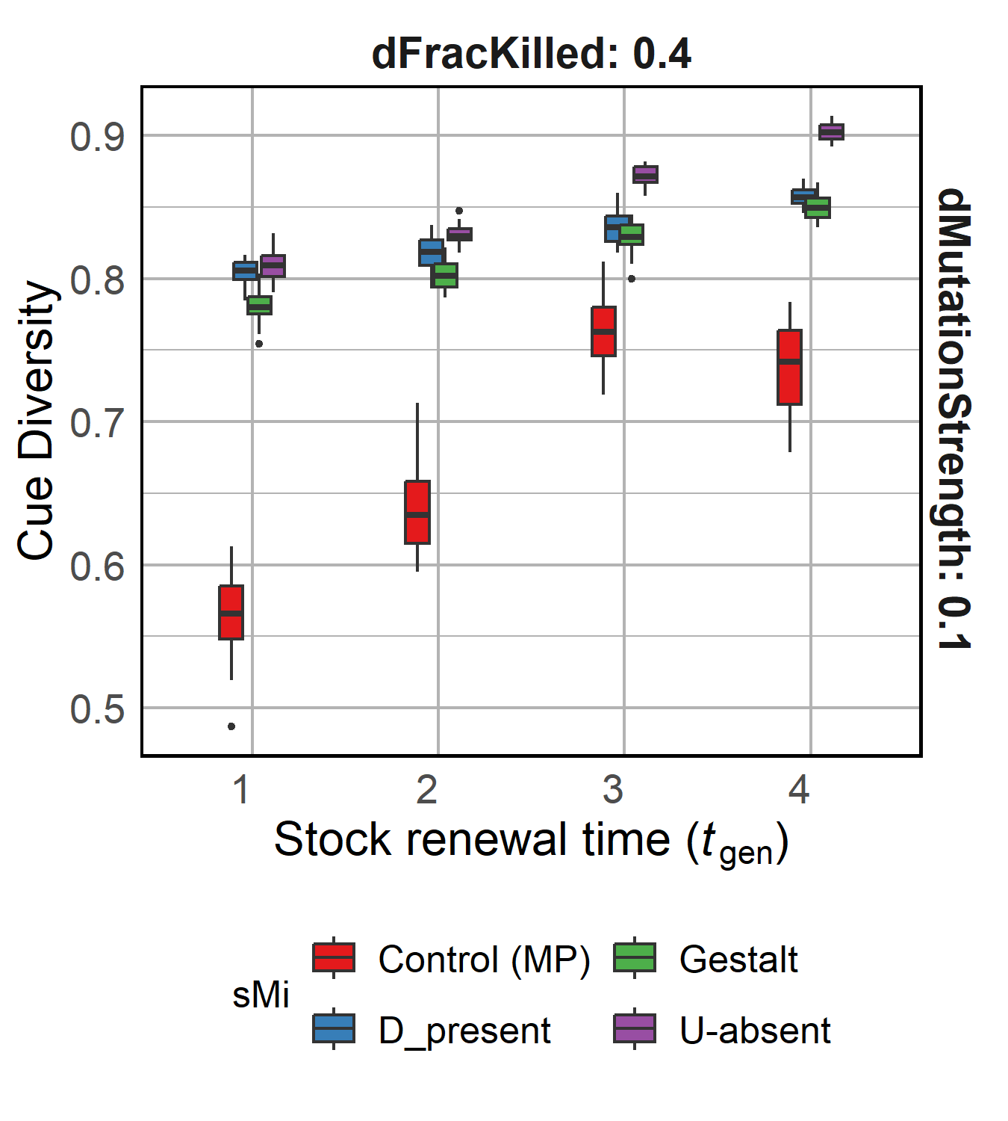
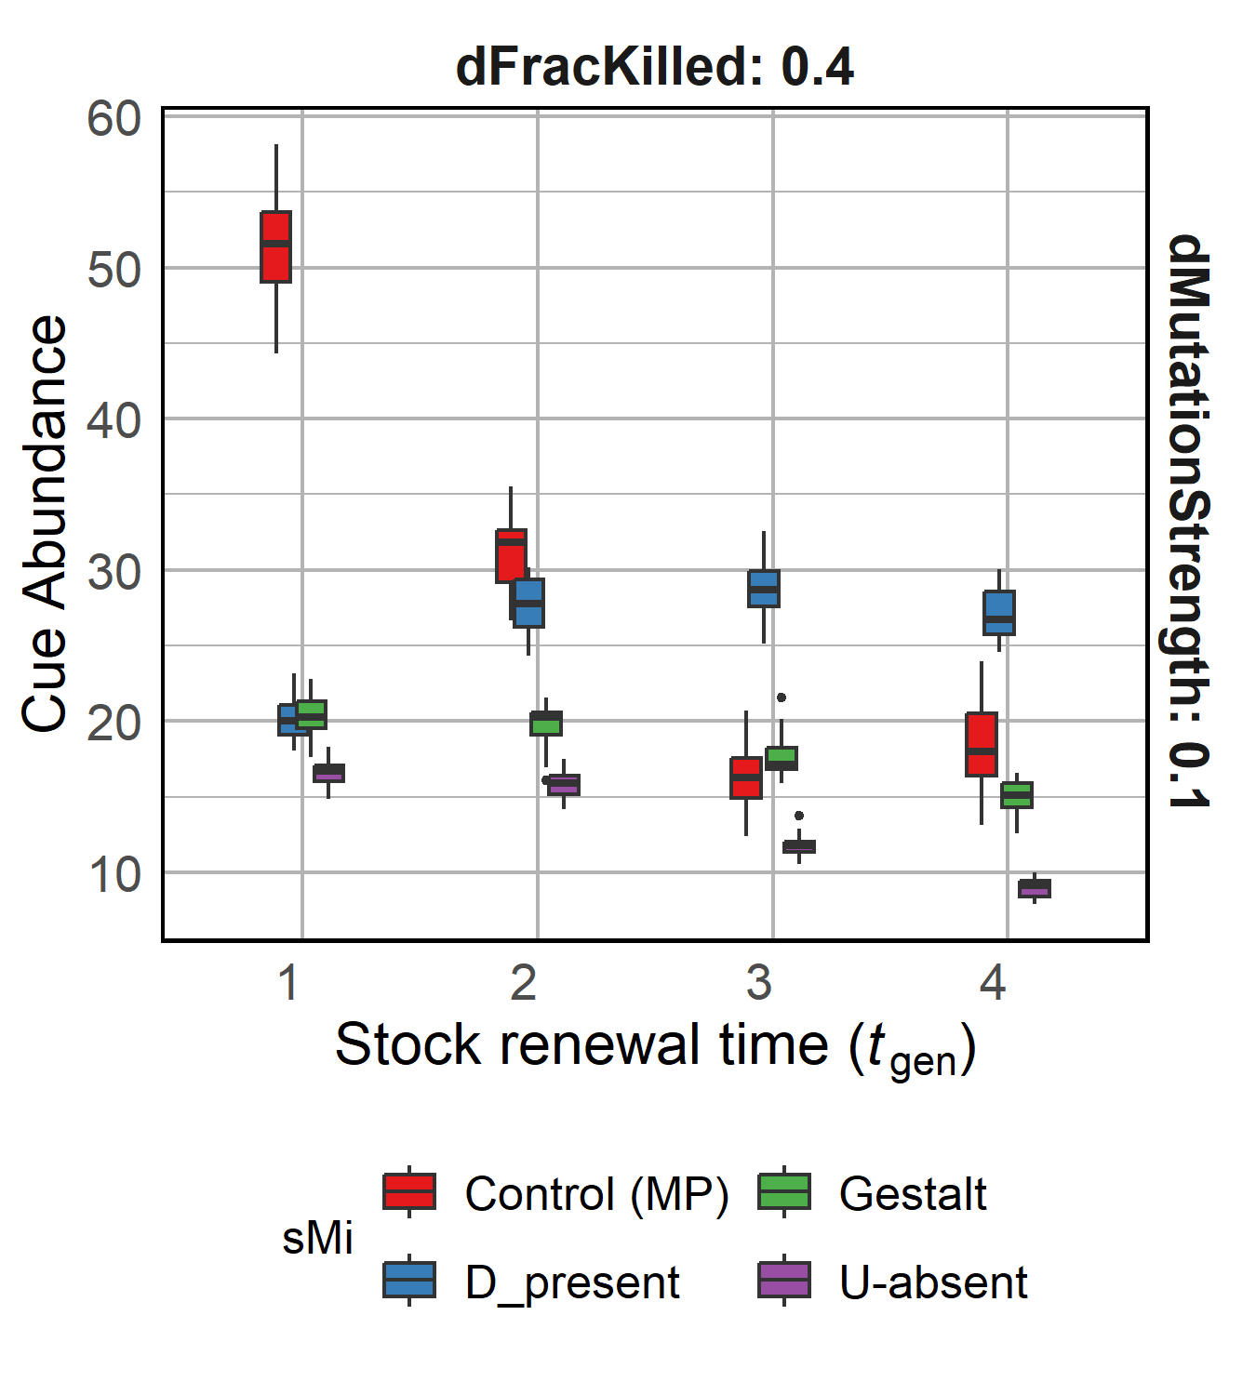
R1.2 Reducing food availability to the population
Decreasing food availability
Decreasing food availability
Increased raiding due to low population food stock necessitates more stringent checks, observed via increased diversity, reduced success of raids and more lineages surviving
Notes:
Cue diversity increases as availability of food decreases.
Cue abundance decreases with decreasing resources, except in D-present recognition model.
Metabolic constraints to D-present

Slide 14
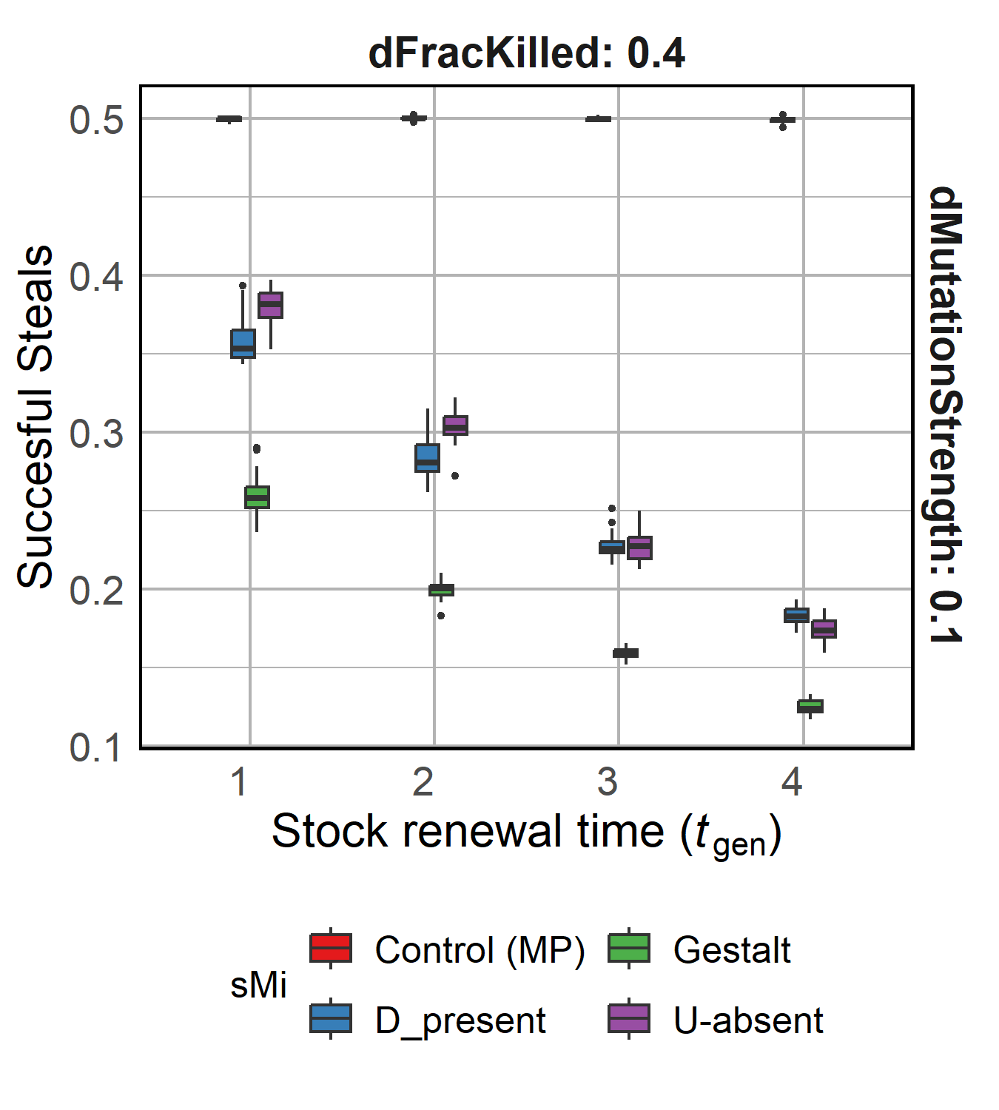
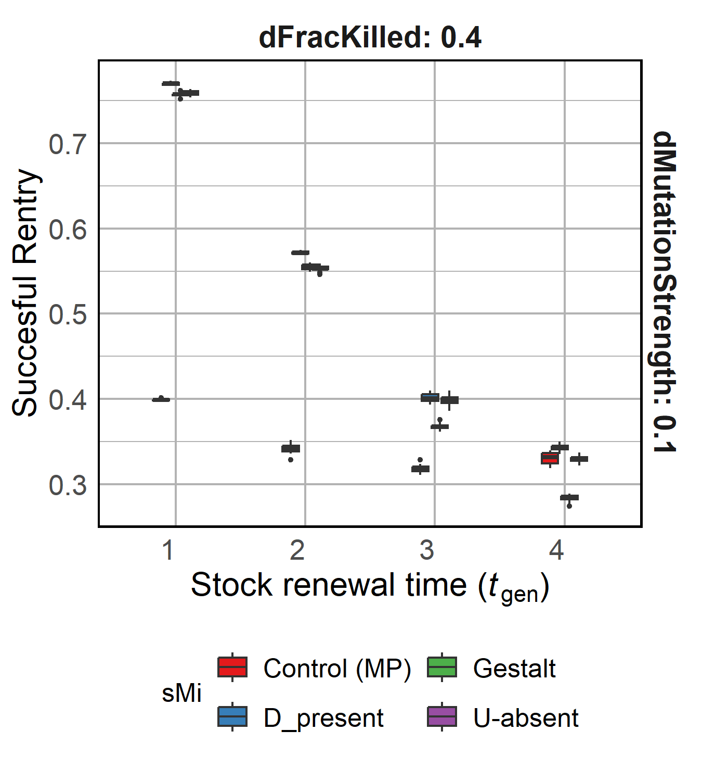
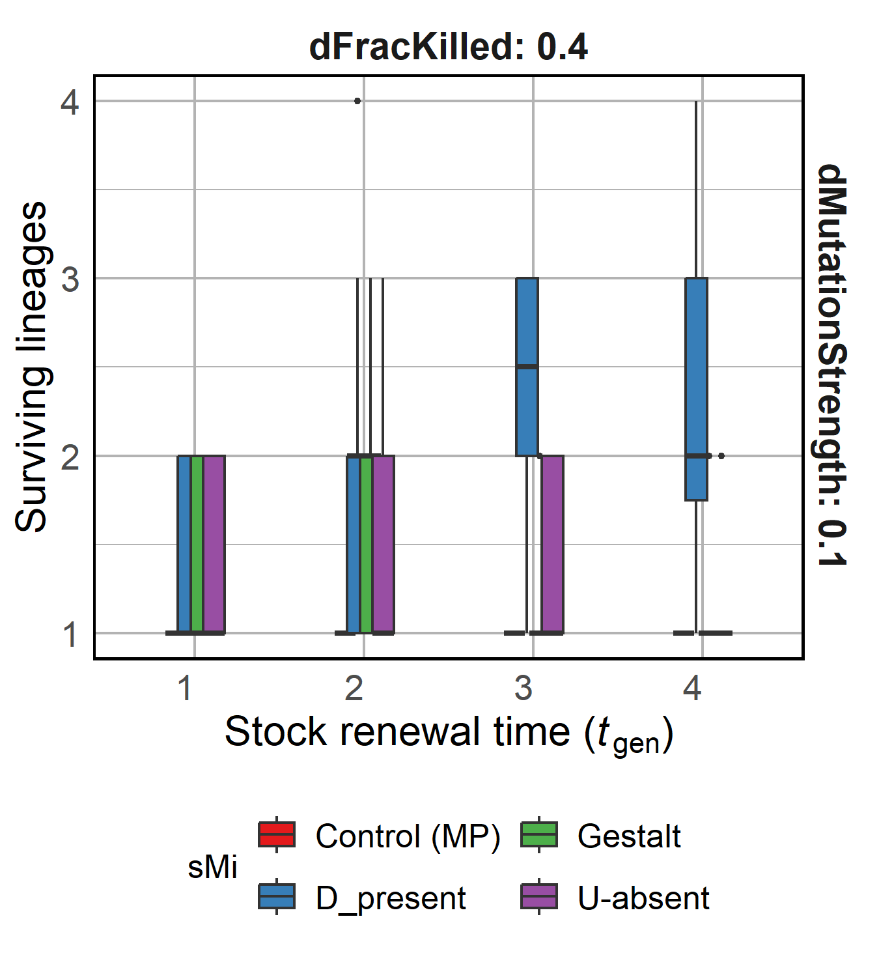
R1.2 Reducing food availability to the population

Slide 15
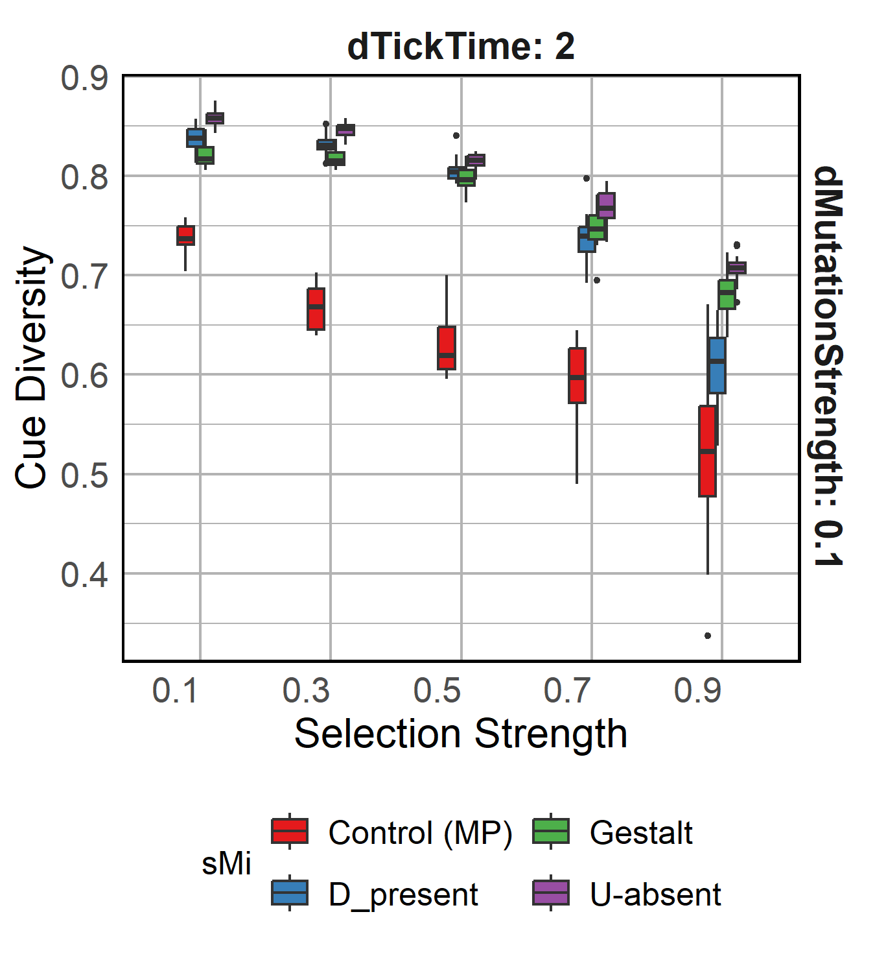
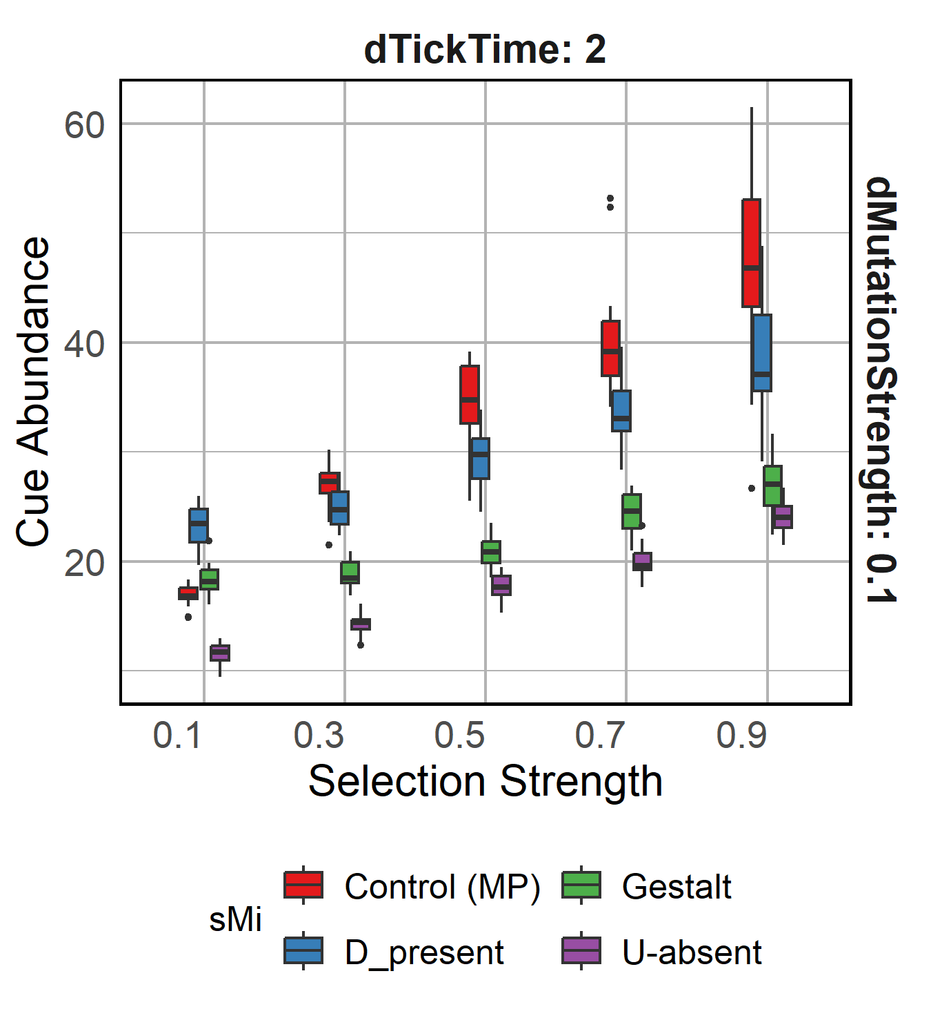
R1.3 Varying Selection Strength
Increasing selection strength
Increasing selection strength
Increasing selection reduces diversity, presumably through a “bottleneck” effect. Increasing stealing success and reducing surviving lineages further suggest reduced diversity.

Slide 16
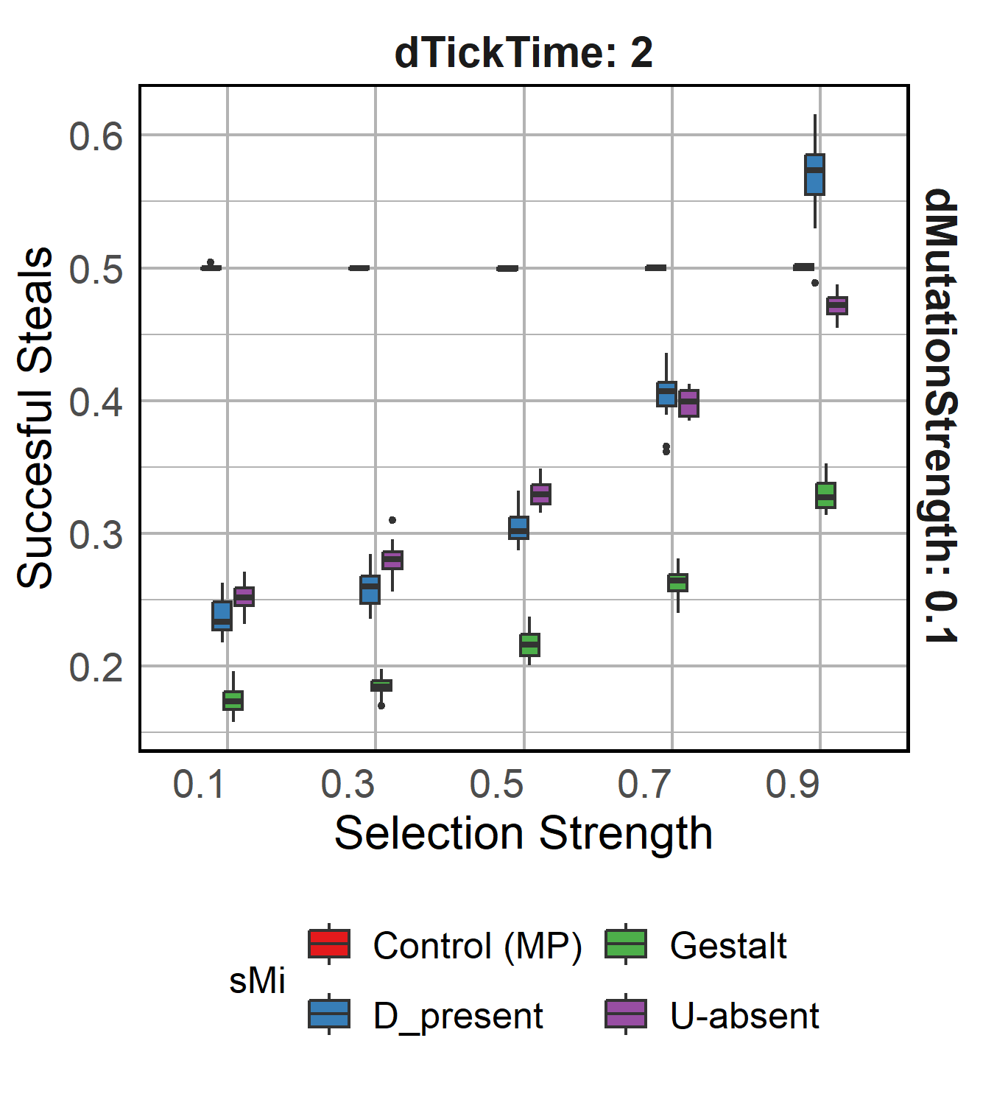
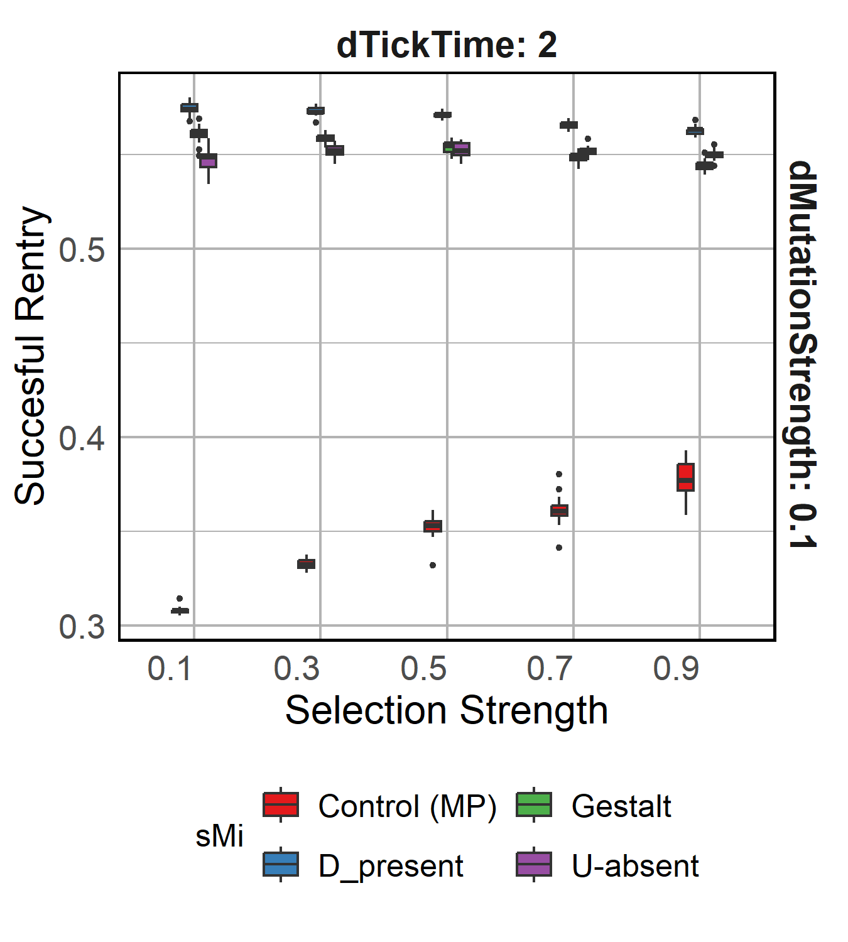
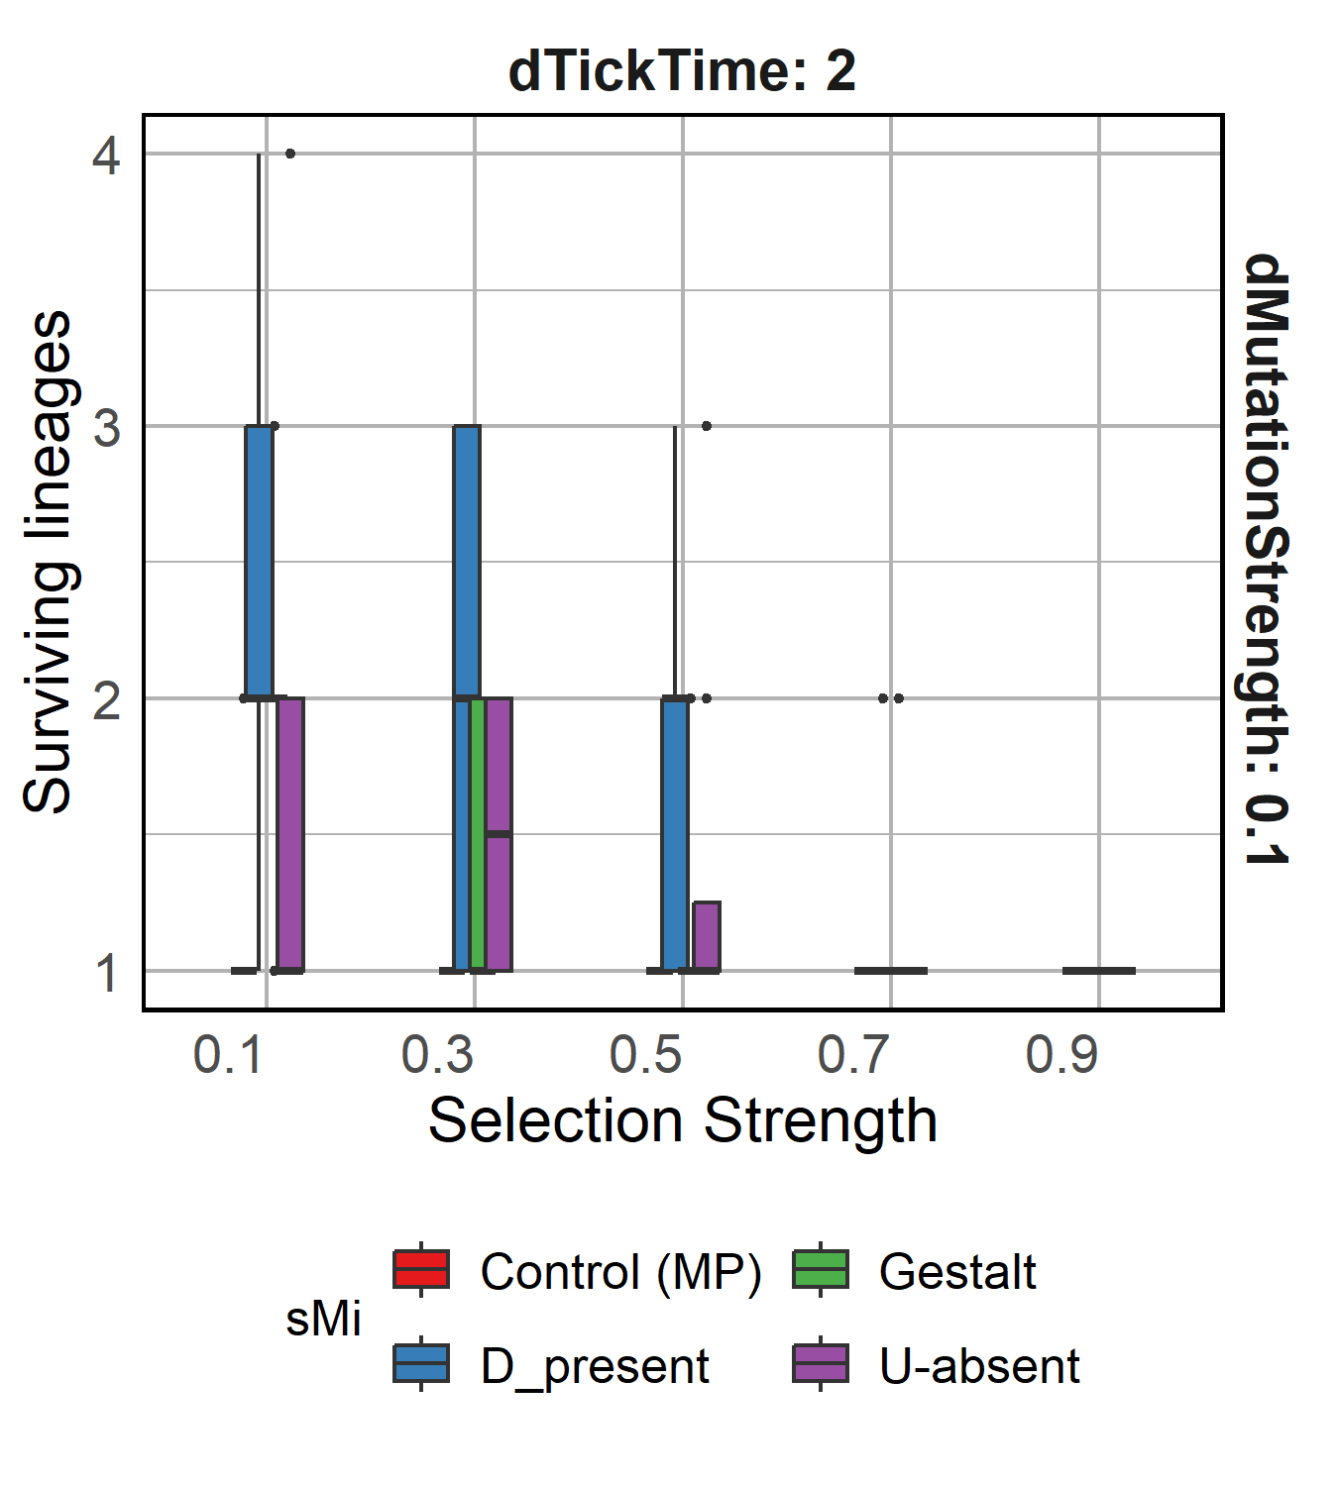
R1.3 Varying Selection Strength

Slide 17
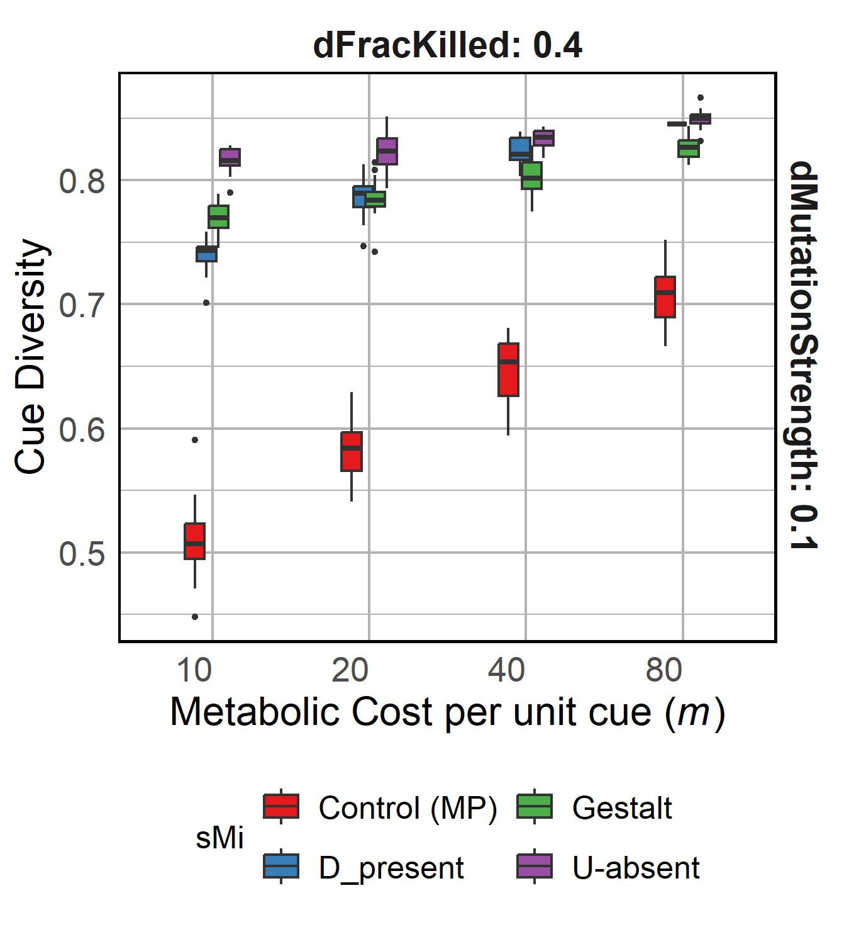
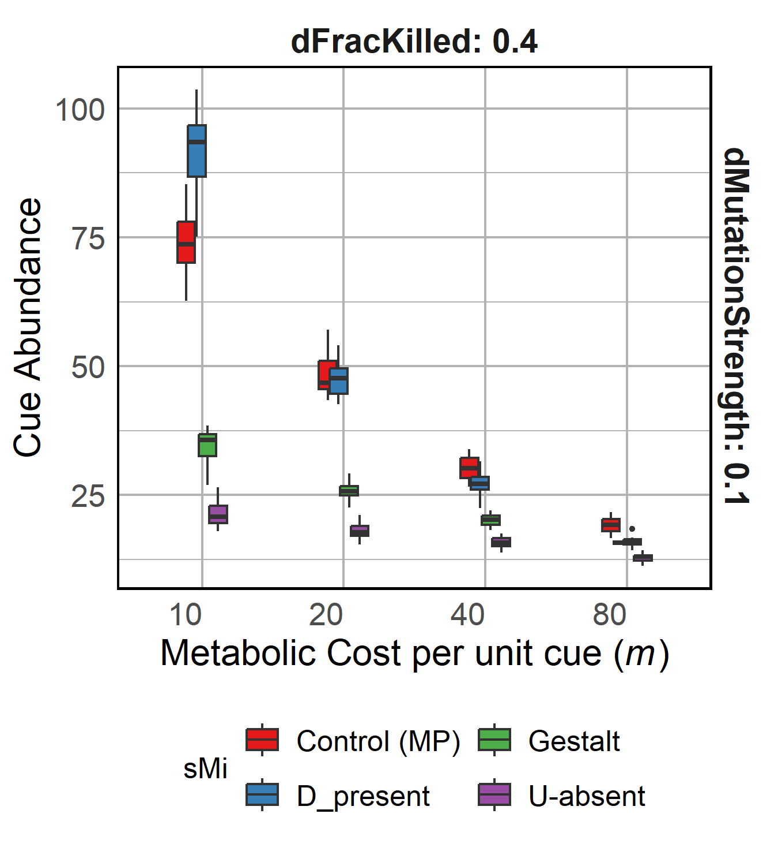
R1.4 Varying Metabolic Costs
Increasing metabolic costs
Increasing metabolic costs
Increasing metabolic costs affect D-present model the most and U-absent the least.
It does not affect the stealing success for any model system.
Notes:
Stealing success of Gestalt??

Slide 18
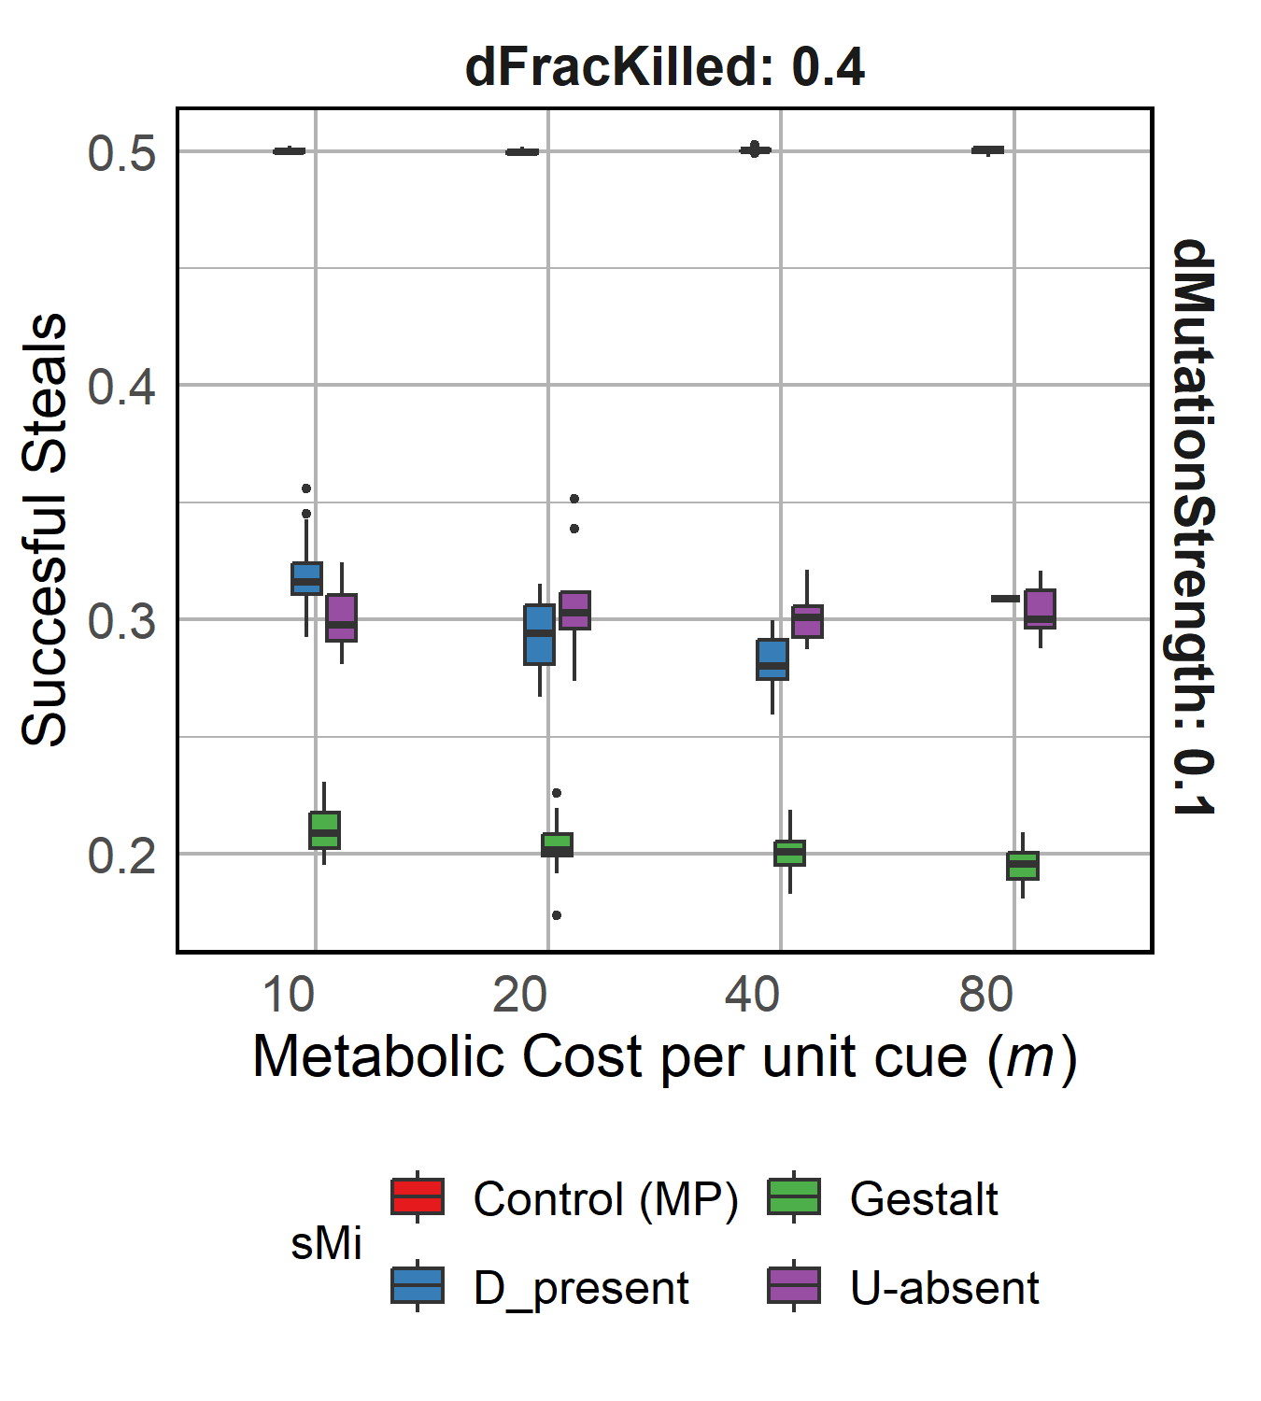
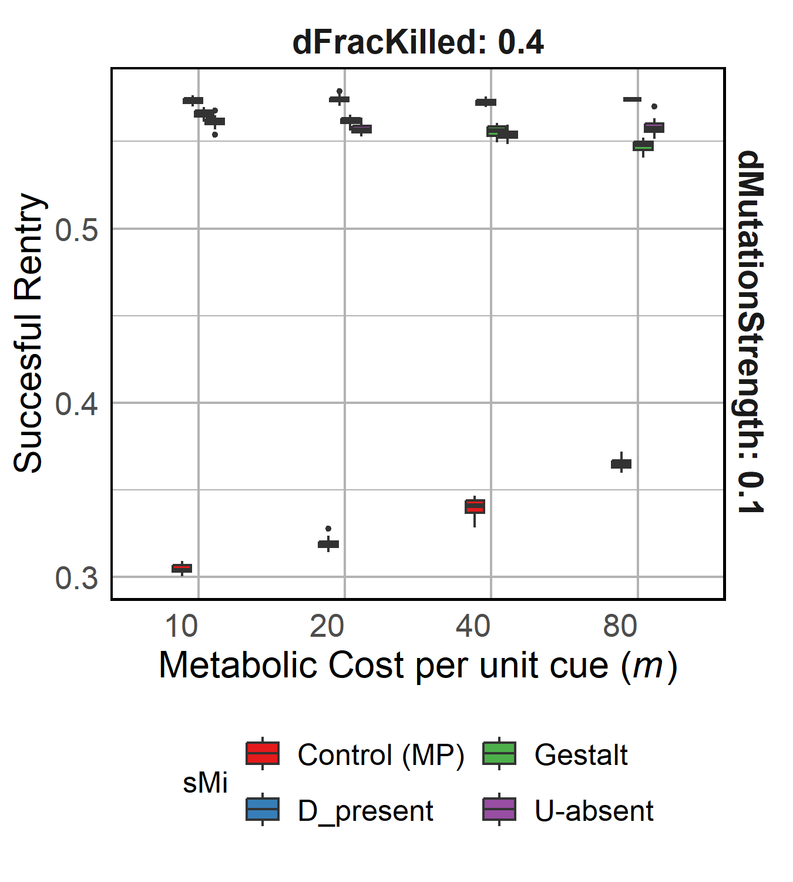
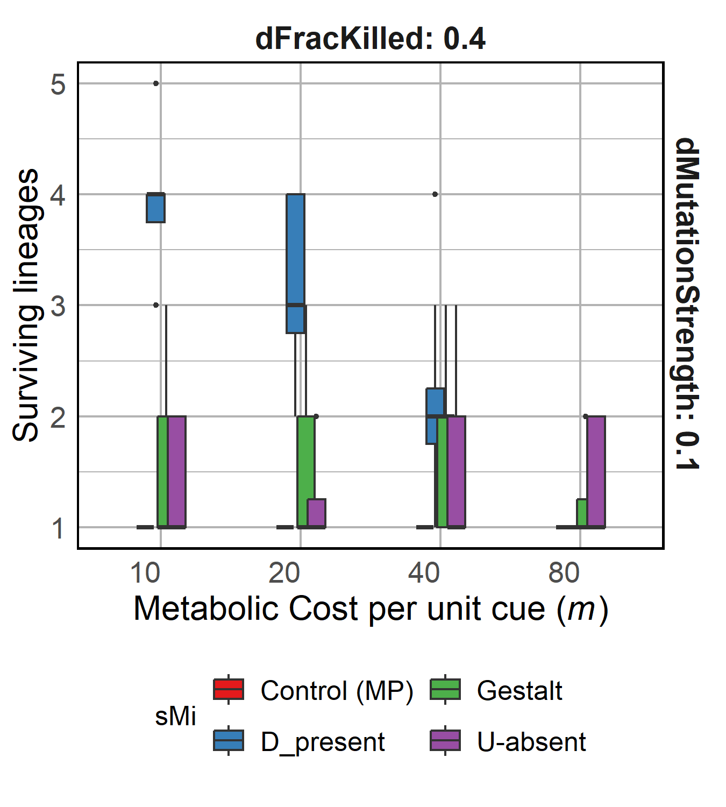
R1.4 Varying Metabolic Costs

Slide 19
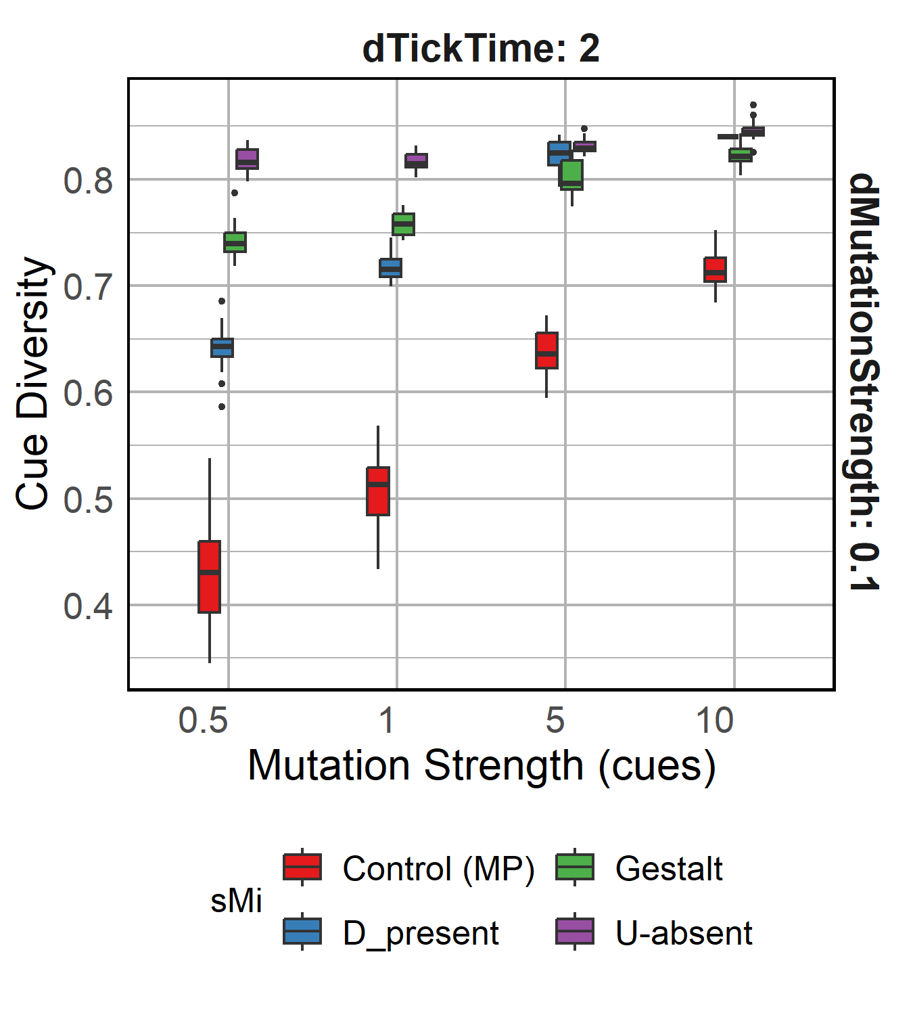
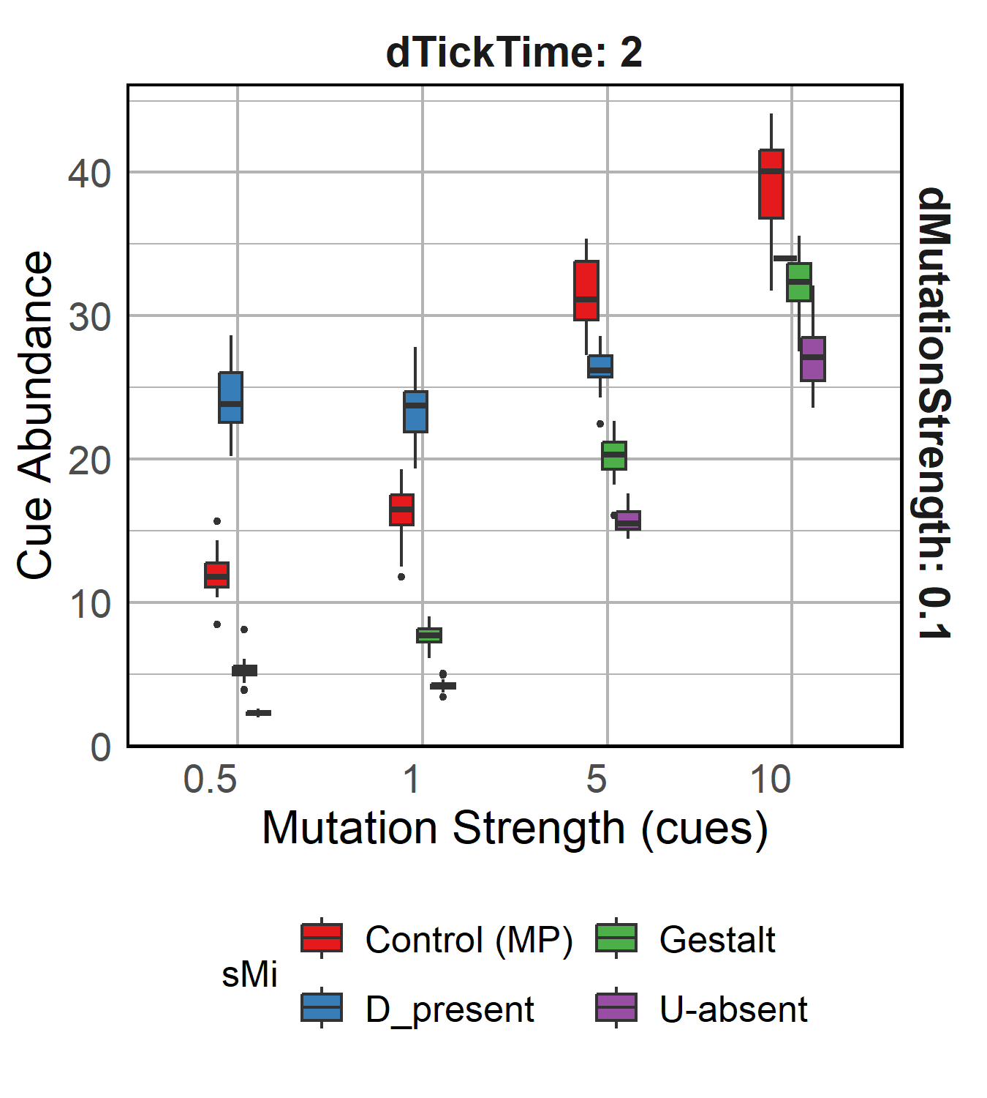
R1.5 Varying mutation strength of cues
Increasing mutation strength
Increasing mutation strength
Varying mutation strength does not affect diversity or stealing success majorly except for D-present model

Slide 20
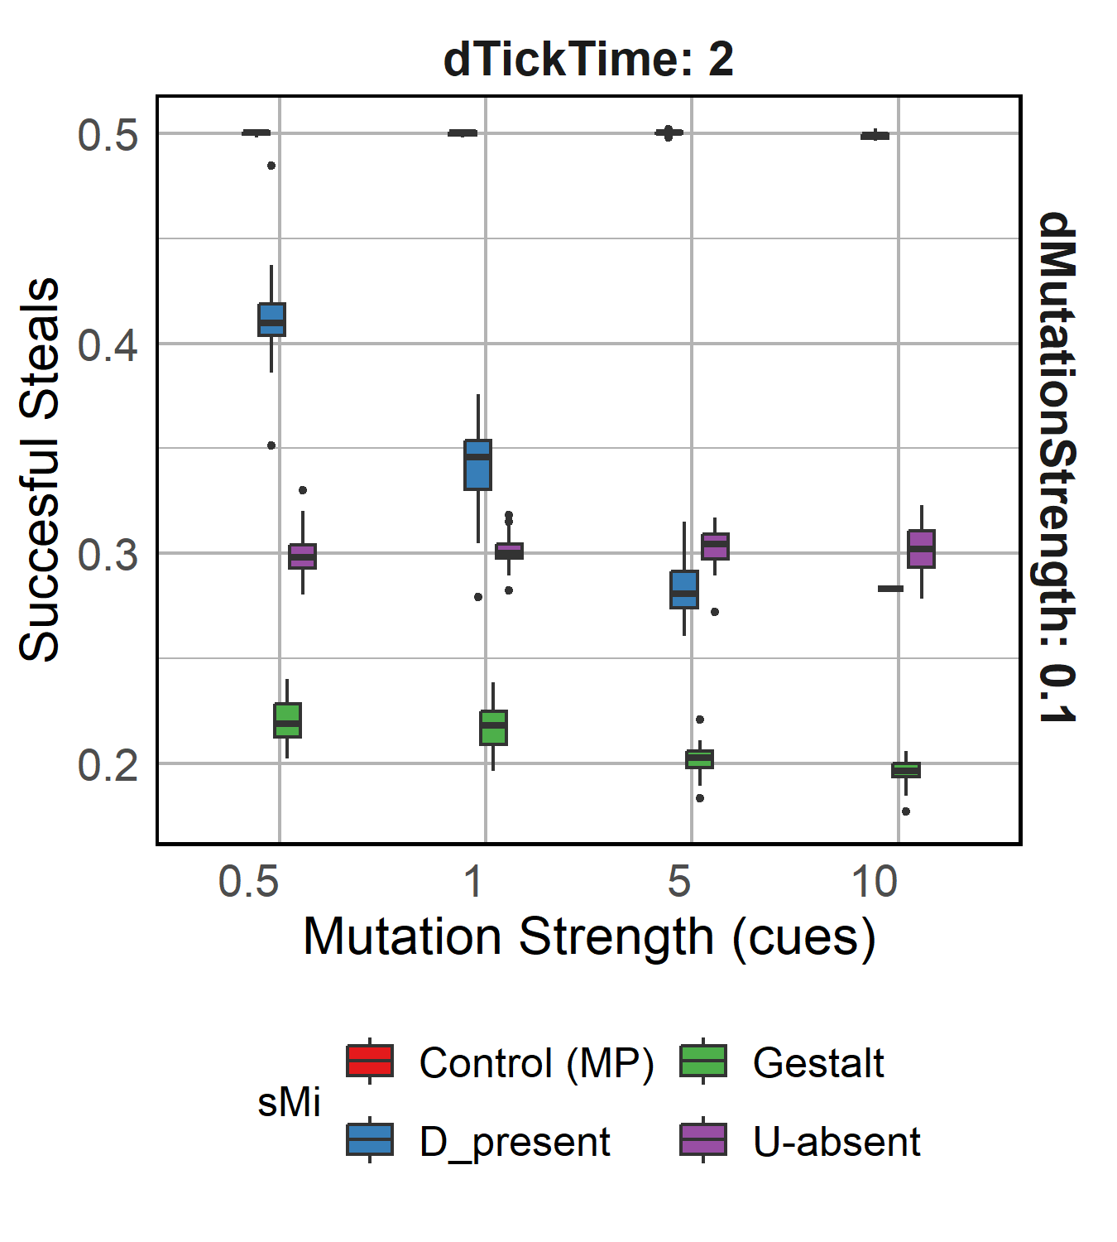
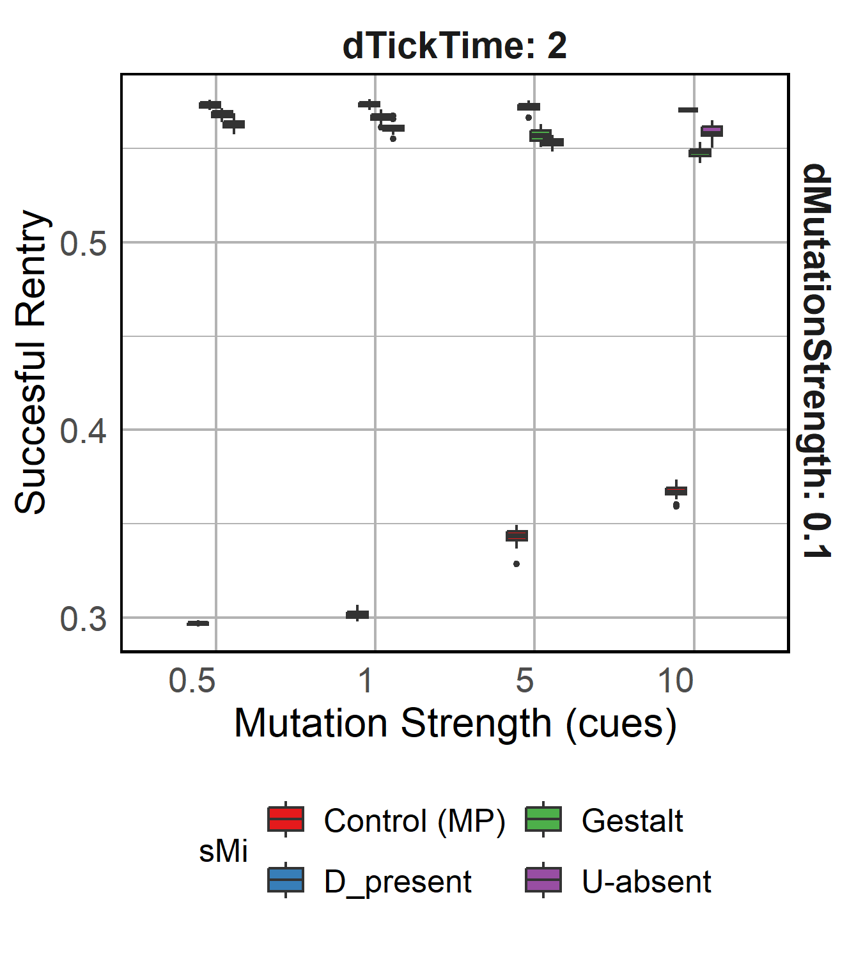
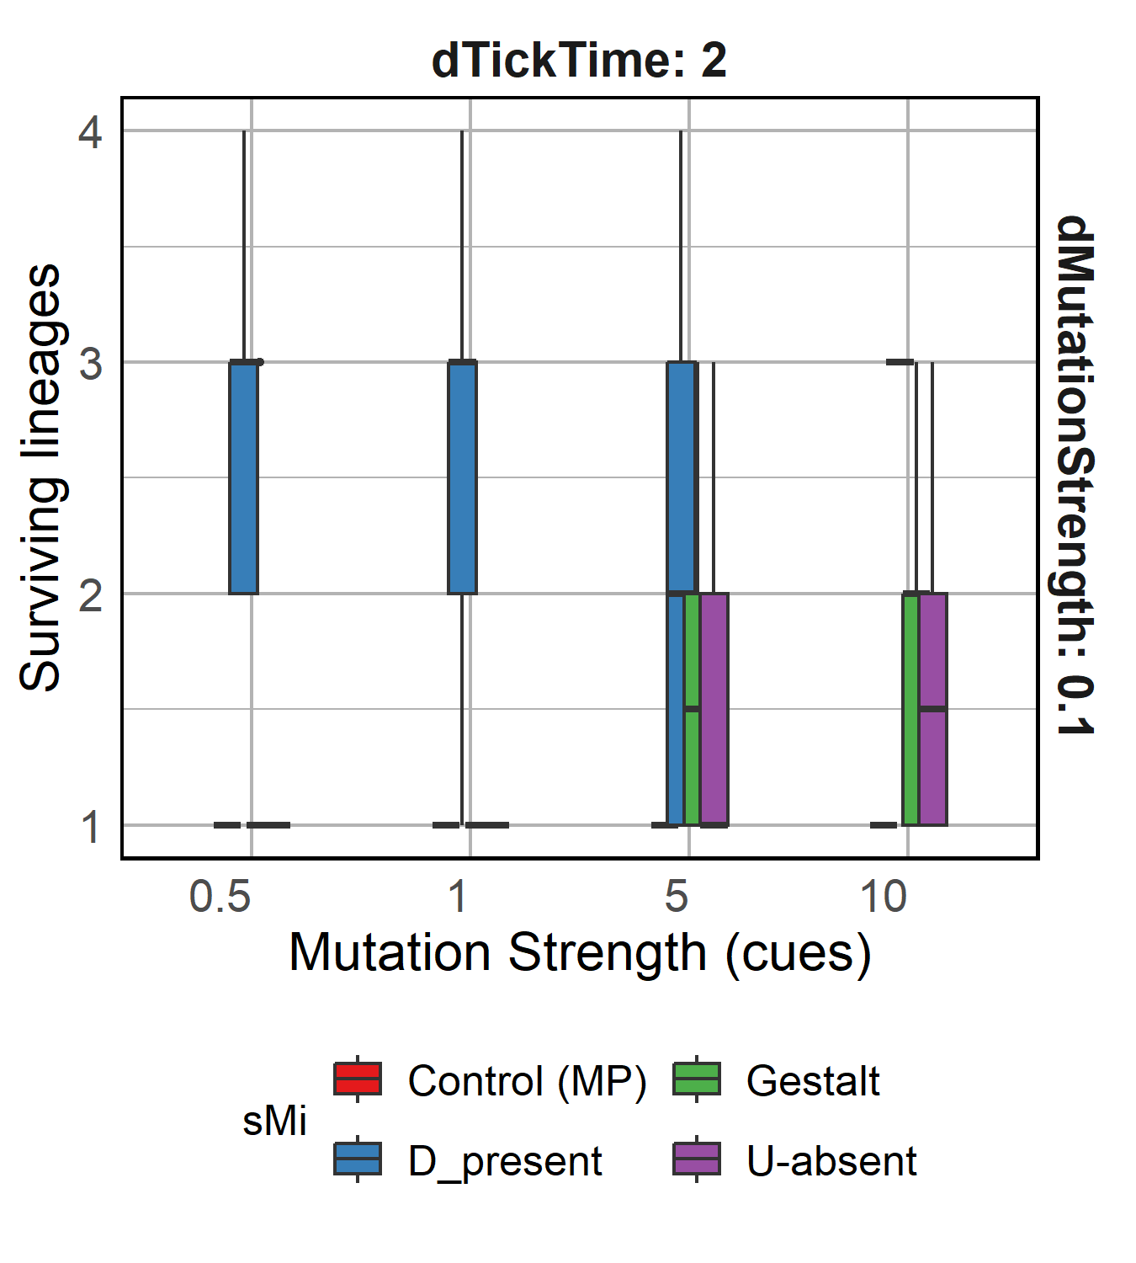
R1.5 Varying mutation strength of cues
Notes:
Cue diversity increases as availability of food decreases.
Cue abundance decreases with decreasing resources, except in D-present recognition model.
Metabolic constraints to D-present

Slide 21
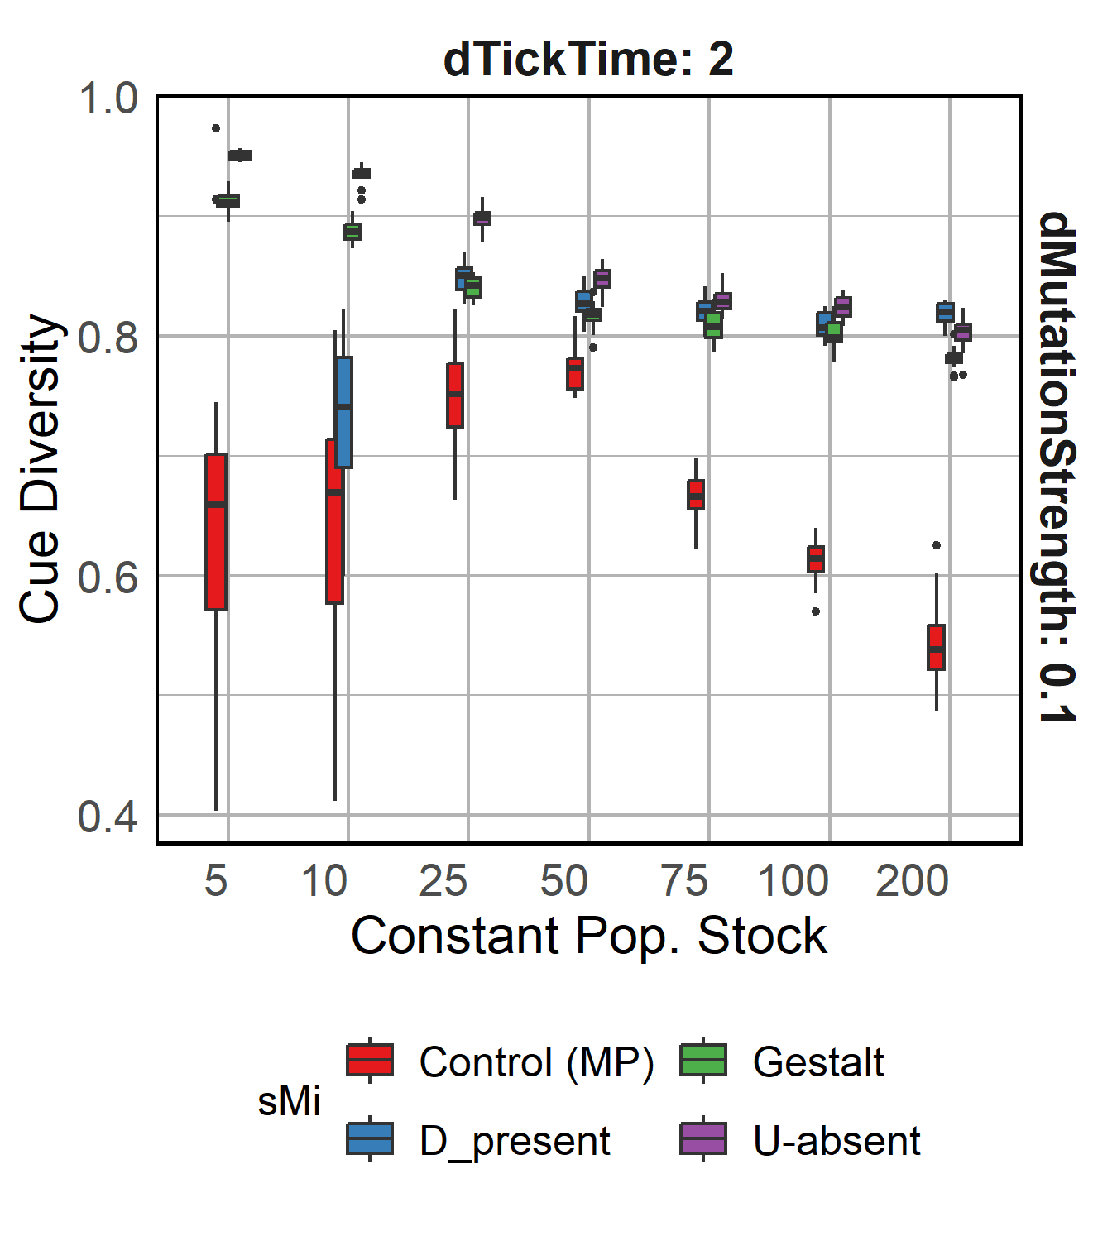
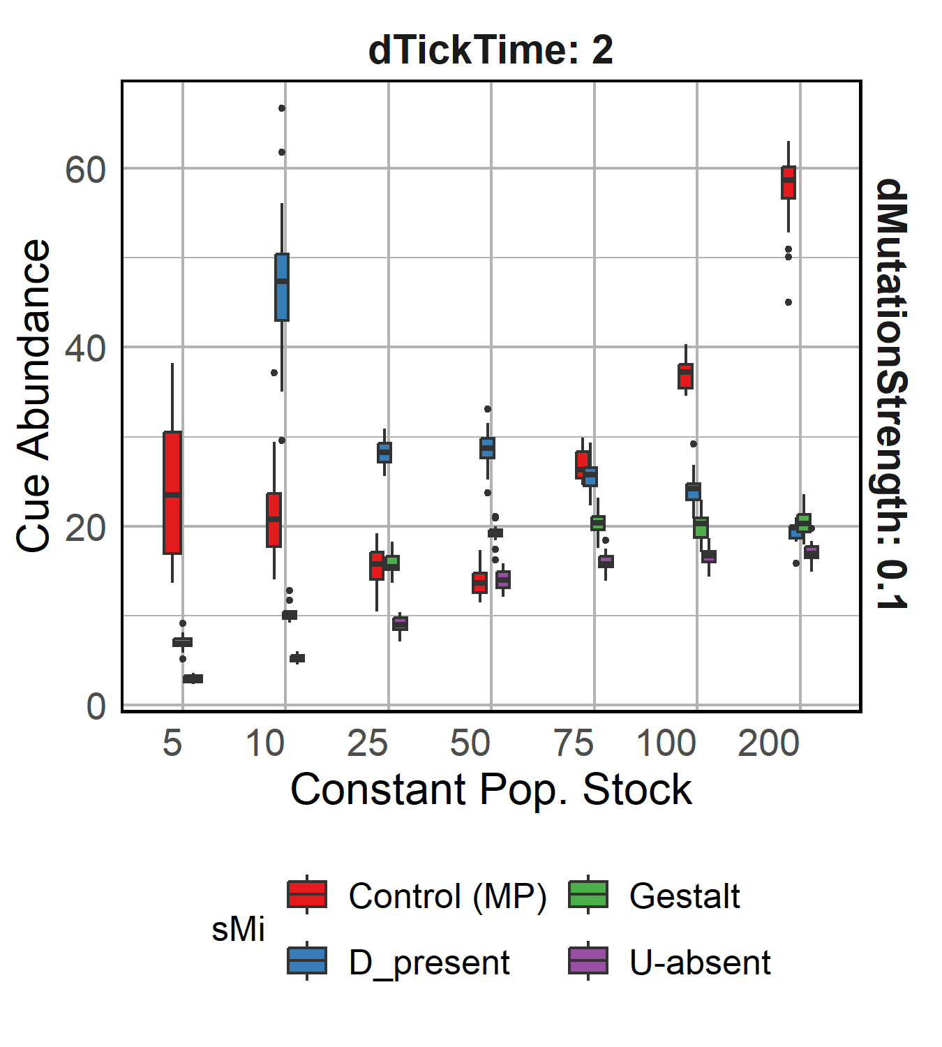
R1.6 Constant population food stock
Increasing food availability
Increasing food availability
Even with high diversity and low food availability (blue box), the constant food availability results low reliance on stealing resources from other nests
Notes:
< Mention low stealing value >

Slide 22
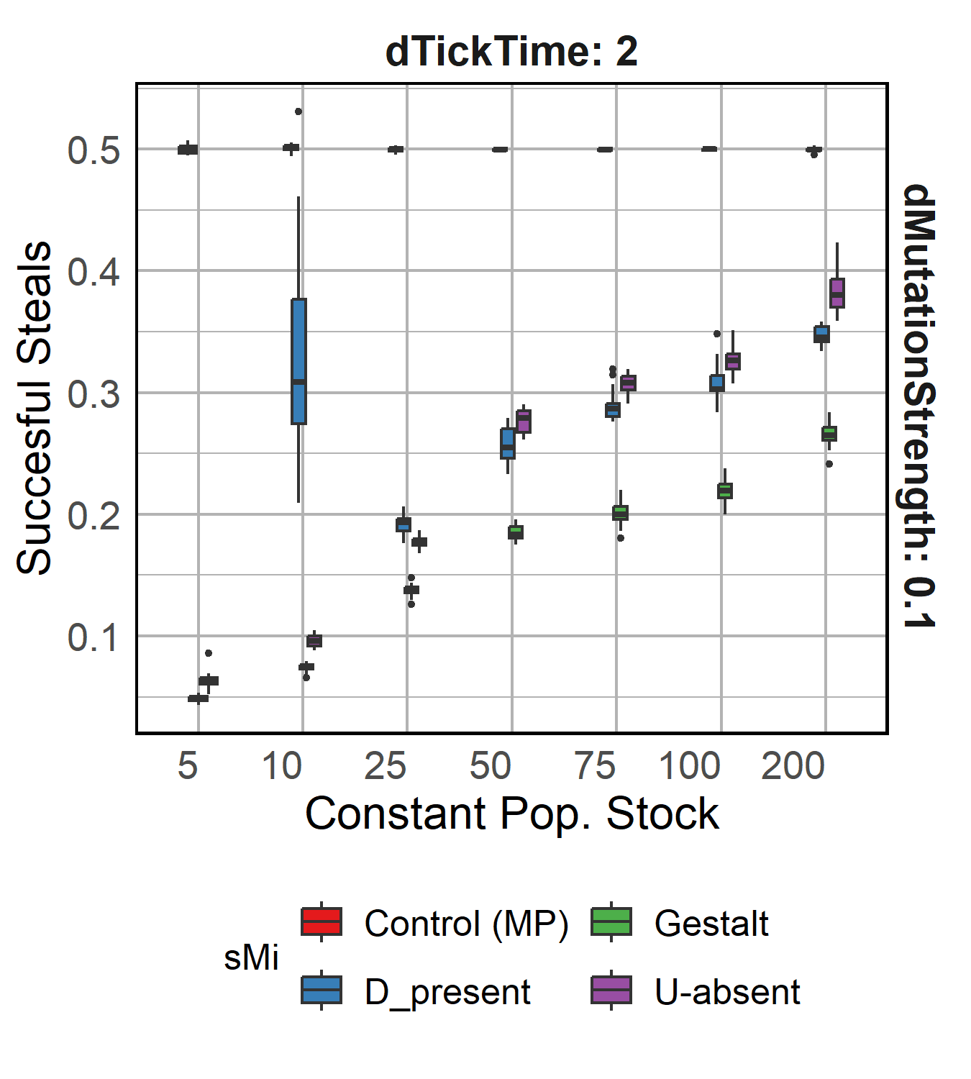
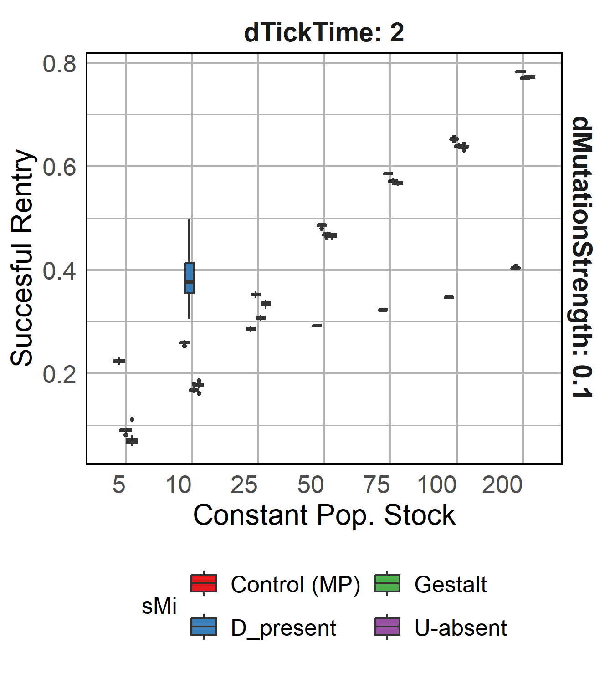
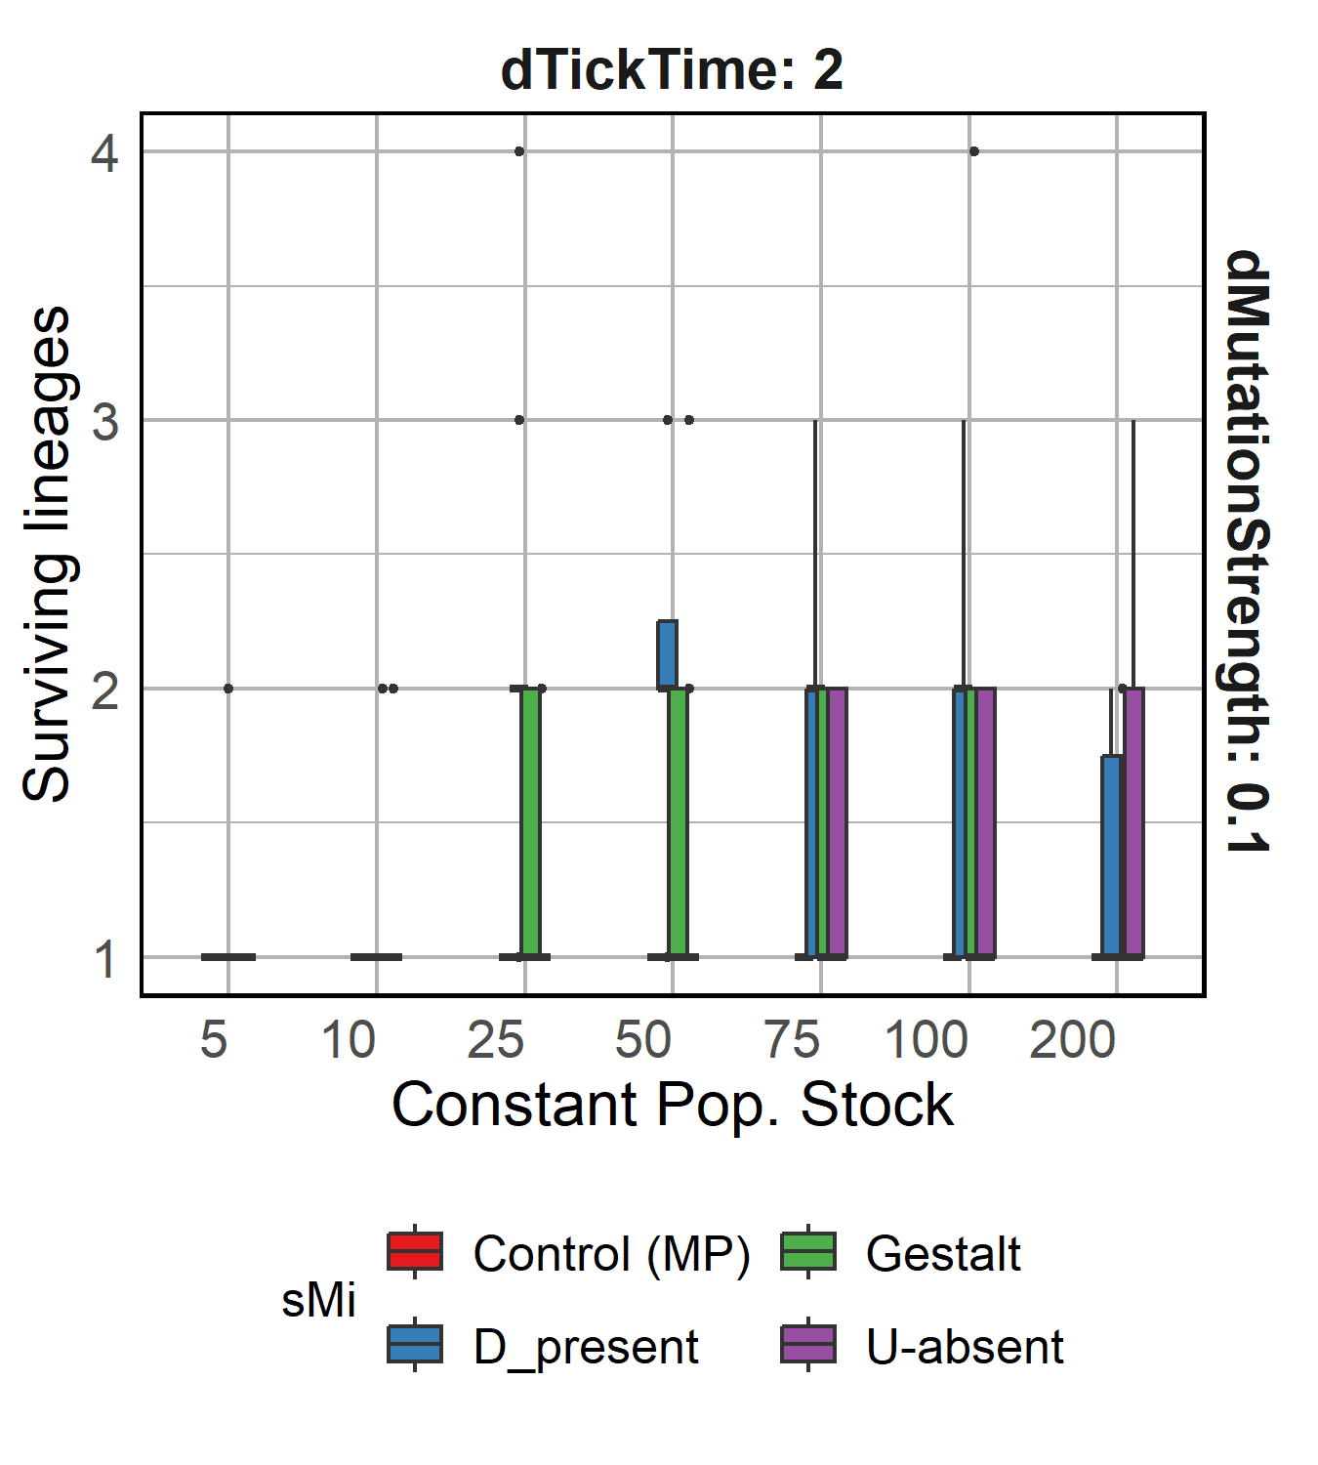
R1.6 Constant population food stock

Slide 23
Results 2: Co-evolving Cues and Perception
Yes, cue diversity can persist in the presence of an evolved recognition system!!
Can cue diversity and a corresponding recognition system co-evolve?

Slide 24



R2.1 Expected recognition curve evolves
Decreasing food availability
Decreasing food availability
Rejection probability
Chemical distance
A stringent cue recognition system evolves, where availability of food does not affect slope and intercept values except for D-present.
Notes:
< Mention low stealing value >

Slide 25


R2.2 Cue diversity increases in a co-evolving system
Yes, cue diversity and a corresponding recognition system can co-evolve!!
Decreasing food availability
Decreasing food availability
Cue diversity shows decreasing trend with decreasing food availability for D-present model, even though success of stealing decreases??
Notes:
< Mention low stealing value > < Non significant >

Slide 26


R2.2 D-present behaves weird (as always)
Notes:
< Mention low stealing value >

Slide 27
Discussion

Slide 28
Conclusions
Lower cue diversity enables effective stealing
Lower cue diversity also allows other to steal
Opposing selection pressures can maintain cue diversity!!
Metabolic costs can help maintain cue diversity
U-absent develops higher diversity than D-present*
Existing recognition systems can be used by chemical cues to resolve Crozier’s paradox and they can also co-evolve
van Zweden & d’Ettorre., 2010 Nehring et al., 2016
Notes:
< Consistently low rates of stealing success >

Slide 29
Next steps
Implement logistic recognition curve
Explore effect of drift on the model?
Analyze trajectories for a better understanding
Explore parameter settings for co-evolution
Notes:
< Consistently low rates of stealing success >

Slide 30

Thanks and questions ☺?

